Slide 1
Ordination with unifrac distance matrix
With various age, gender subgroups and food tree levels

Slide 2
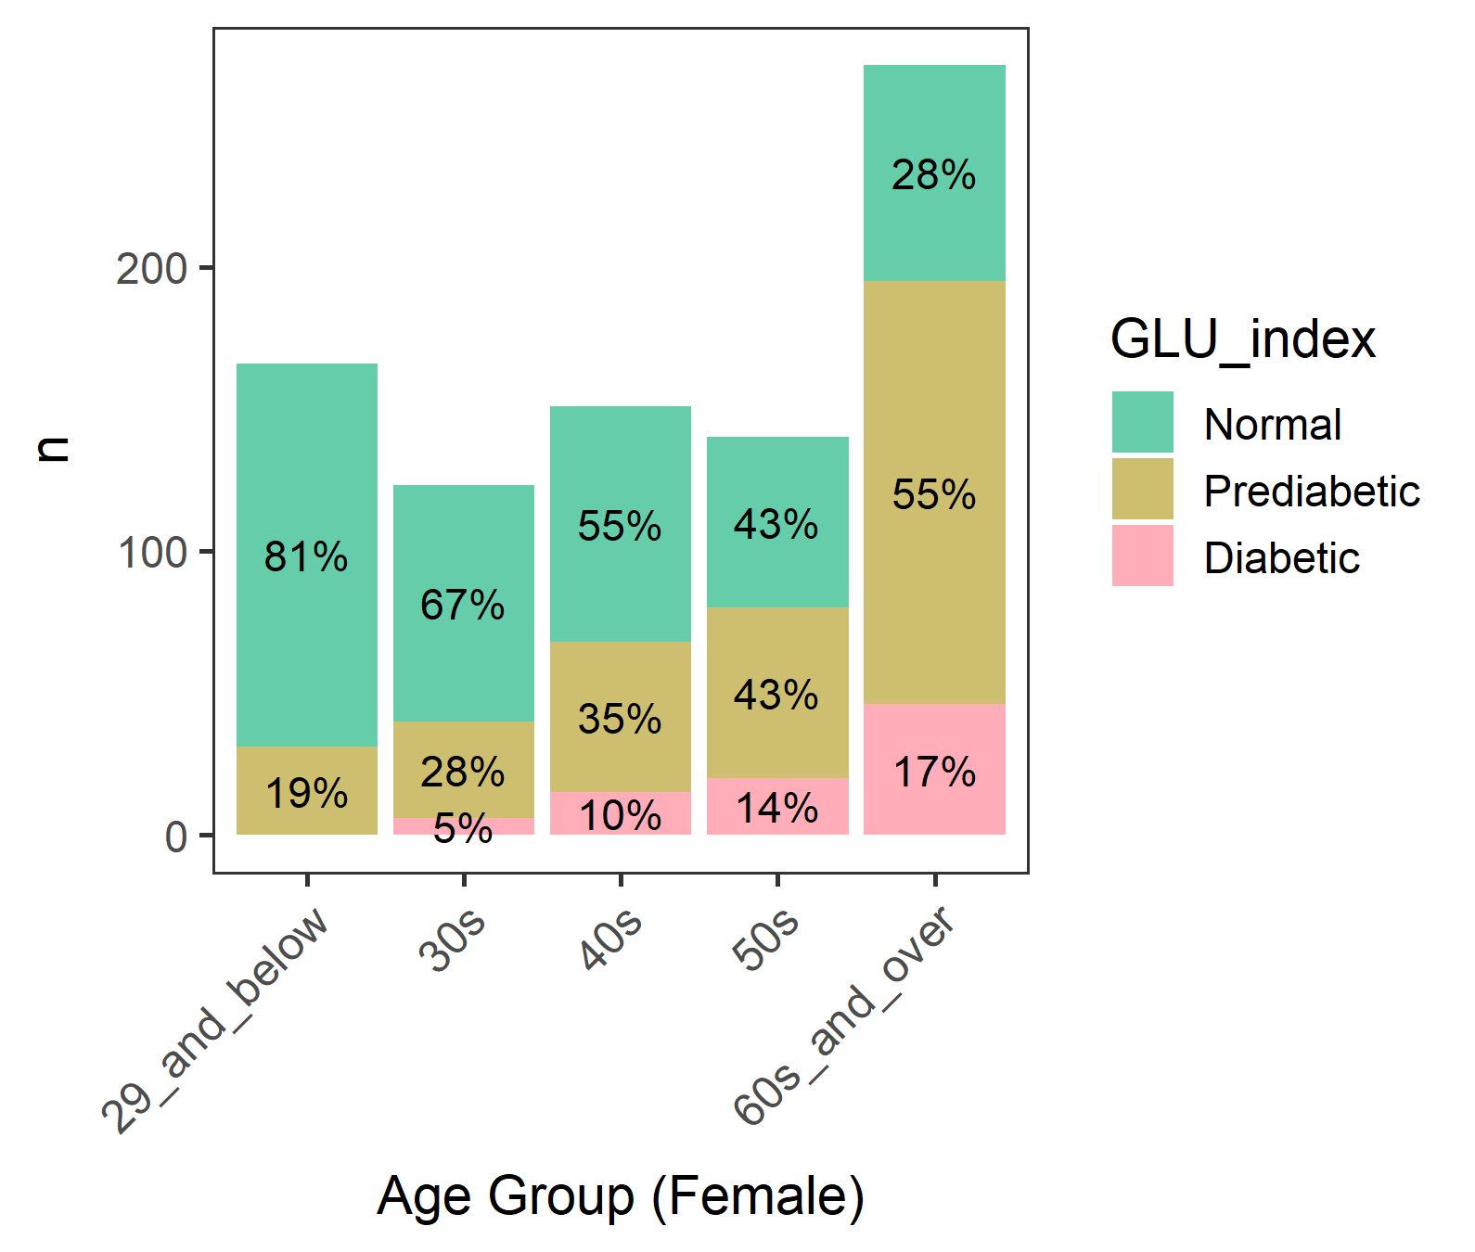
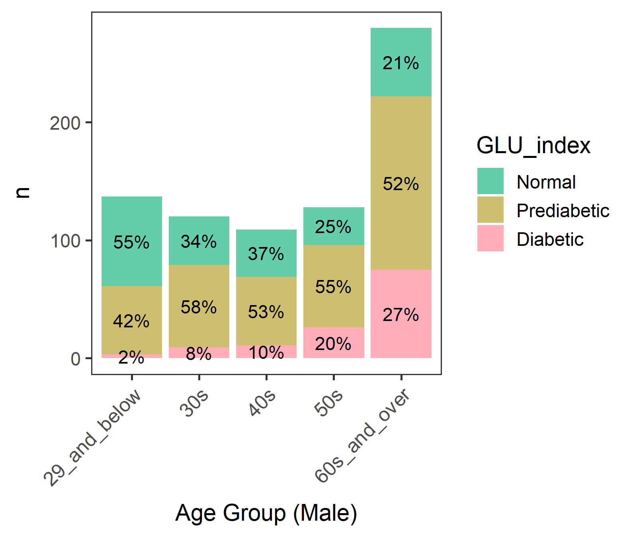
Diabetic groups by gender and age
We focused on male >= 60 where diabetes is most common

Slide 3
Male - Diabetic groups by age
A lot of 80 year-olds. Perhaps 80 or older were grouped.
(Age) 60 61 62 63 64 65 66 67 68 69 70 71 72 73 74 75 76 77 78 79 80
(n) 17 22 14 12 13 17 14 11 8 13 15 11 11 9 12 11 9 7 6 5 43
80+ may not be eating as freely as others due to nursing homes or meal assistance.
But their Normal/Prediabetic/Diabetics percentages are similar to other ages, so should be OK…

Slide 4
Male in 60 and older (60 plus)

Slide 5
Ordination with unifrac distance matrices

Slide 6
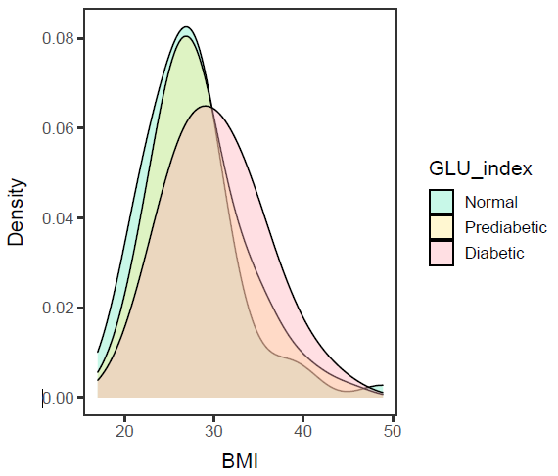
Male in 60 plus, BMI
ANOVA – significant (p-value= 0.0032).
Diabetic is different from Normal and Prediabetic, but
Normal and Prediabetic are not different.
data: df$BMXBMI and df$GLU_index
Normal Prediabetic
Prediabetic 0.1716 -
Diabetic 0.0033 0.0215
Diabetic group has a higher mean BMI than Prediabetic and Normal group.

Slide 7
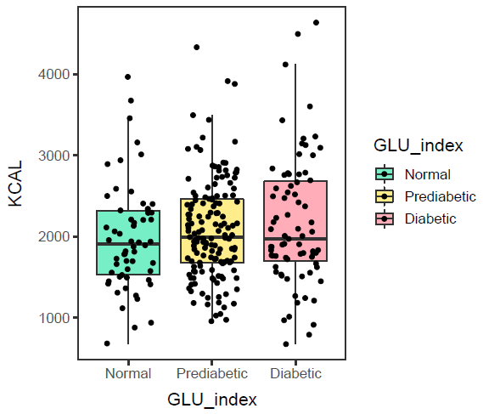
Male in 60 plus, KCAL
ANOVA – not significant (p-value=0.308).
Hmm, so no need to control KCAL intake.
Calorie intake of Normal, Prediabetic, and Diabetic groups are not different.

Slide 8
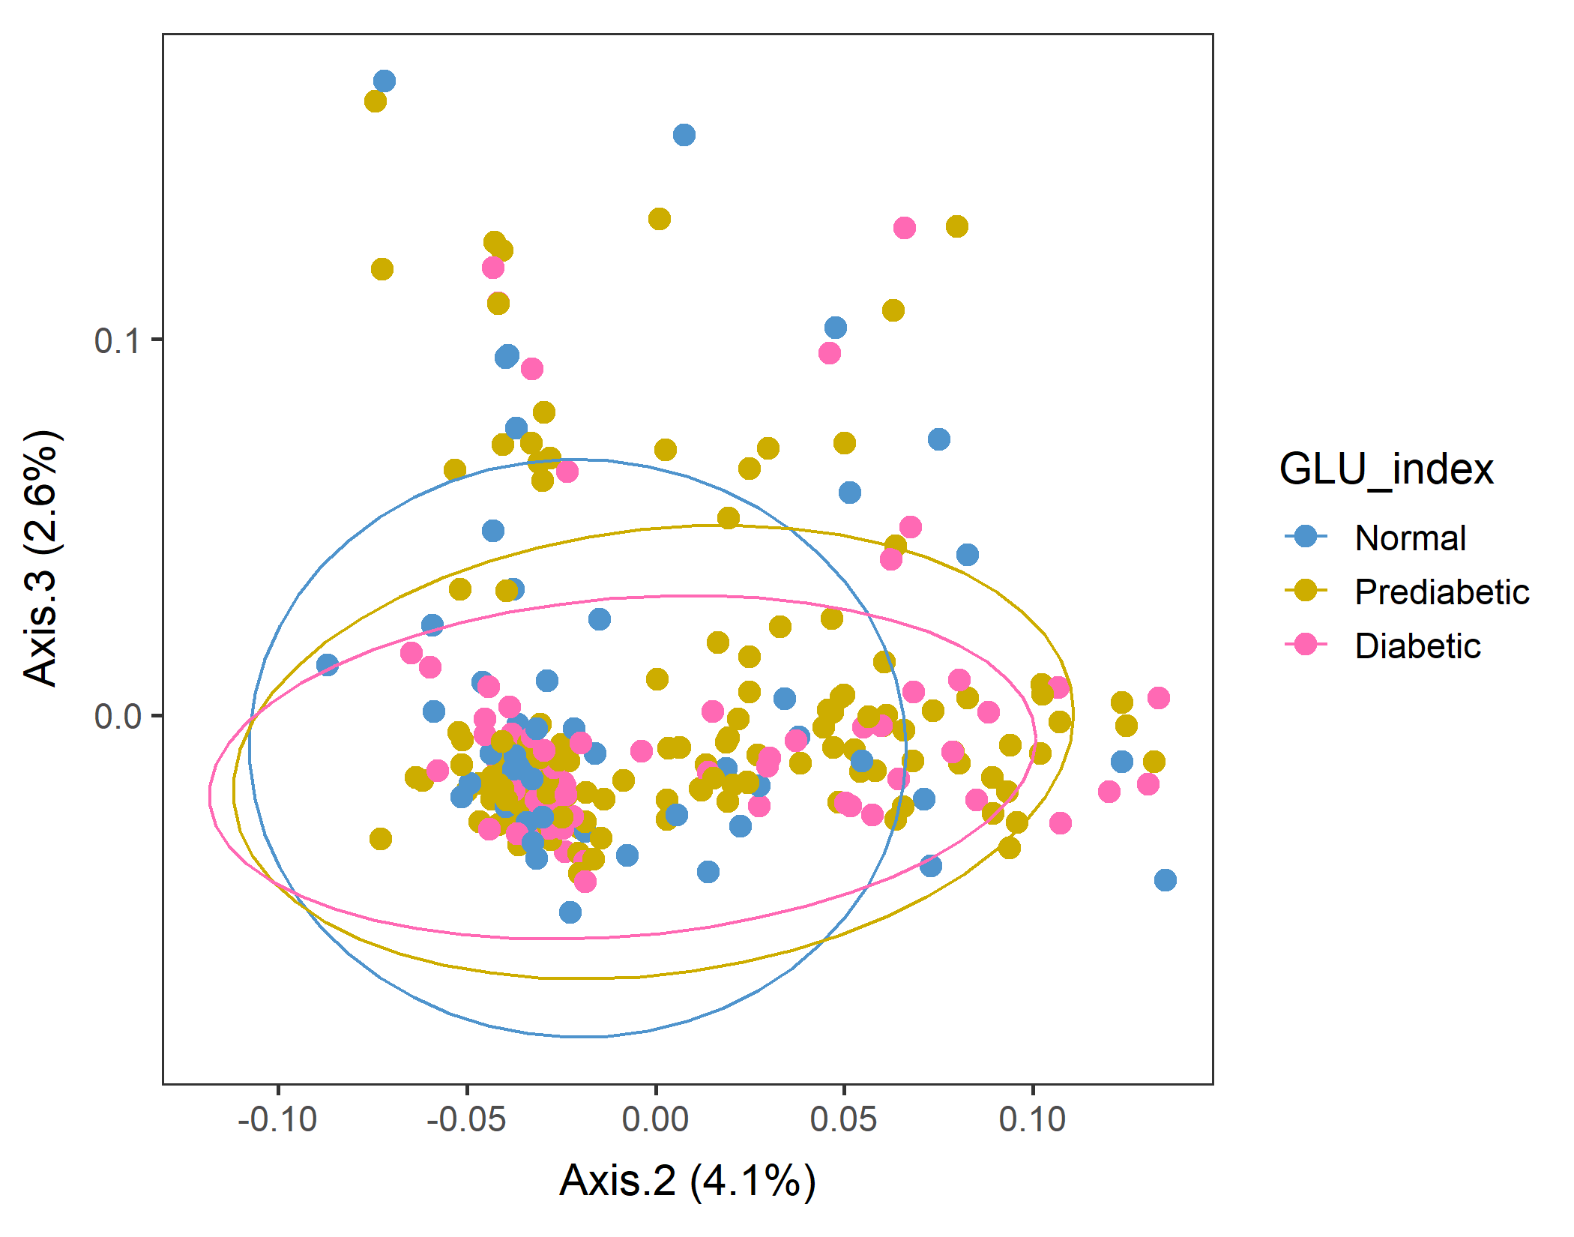
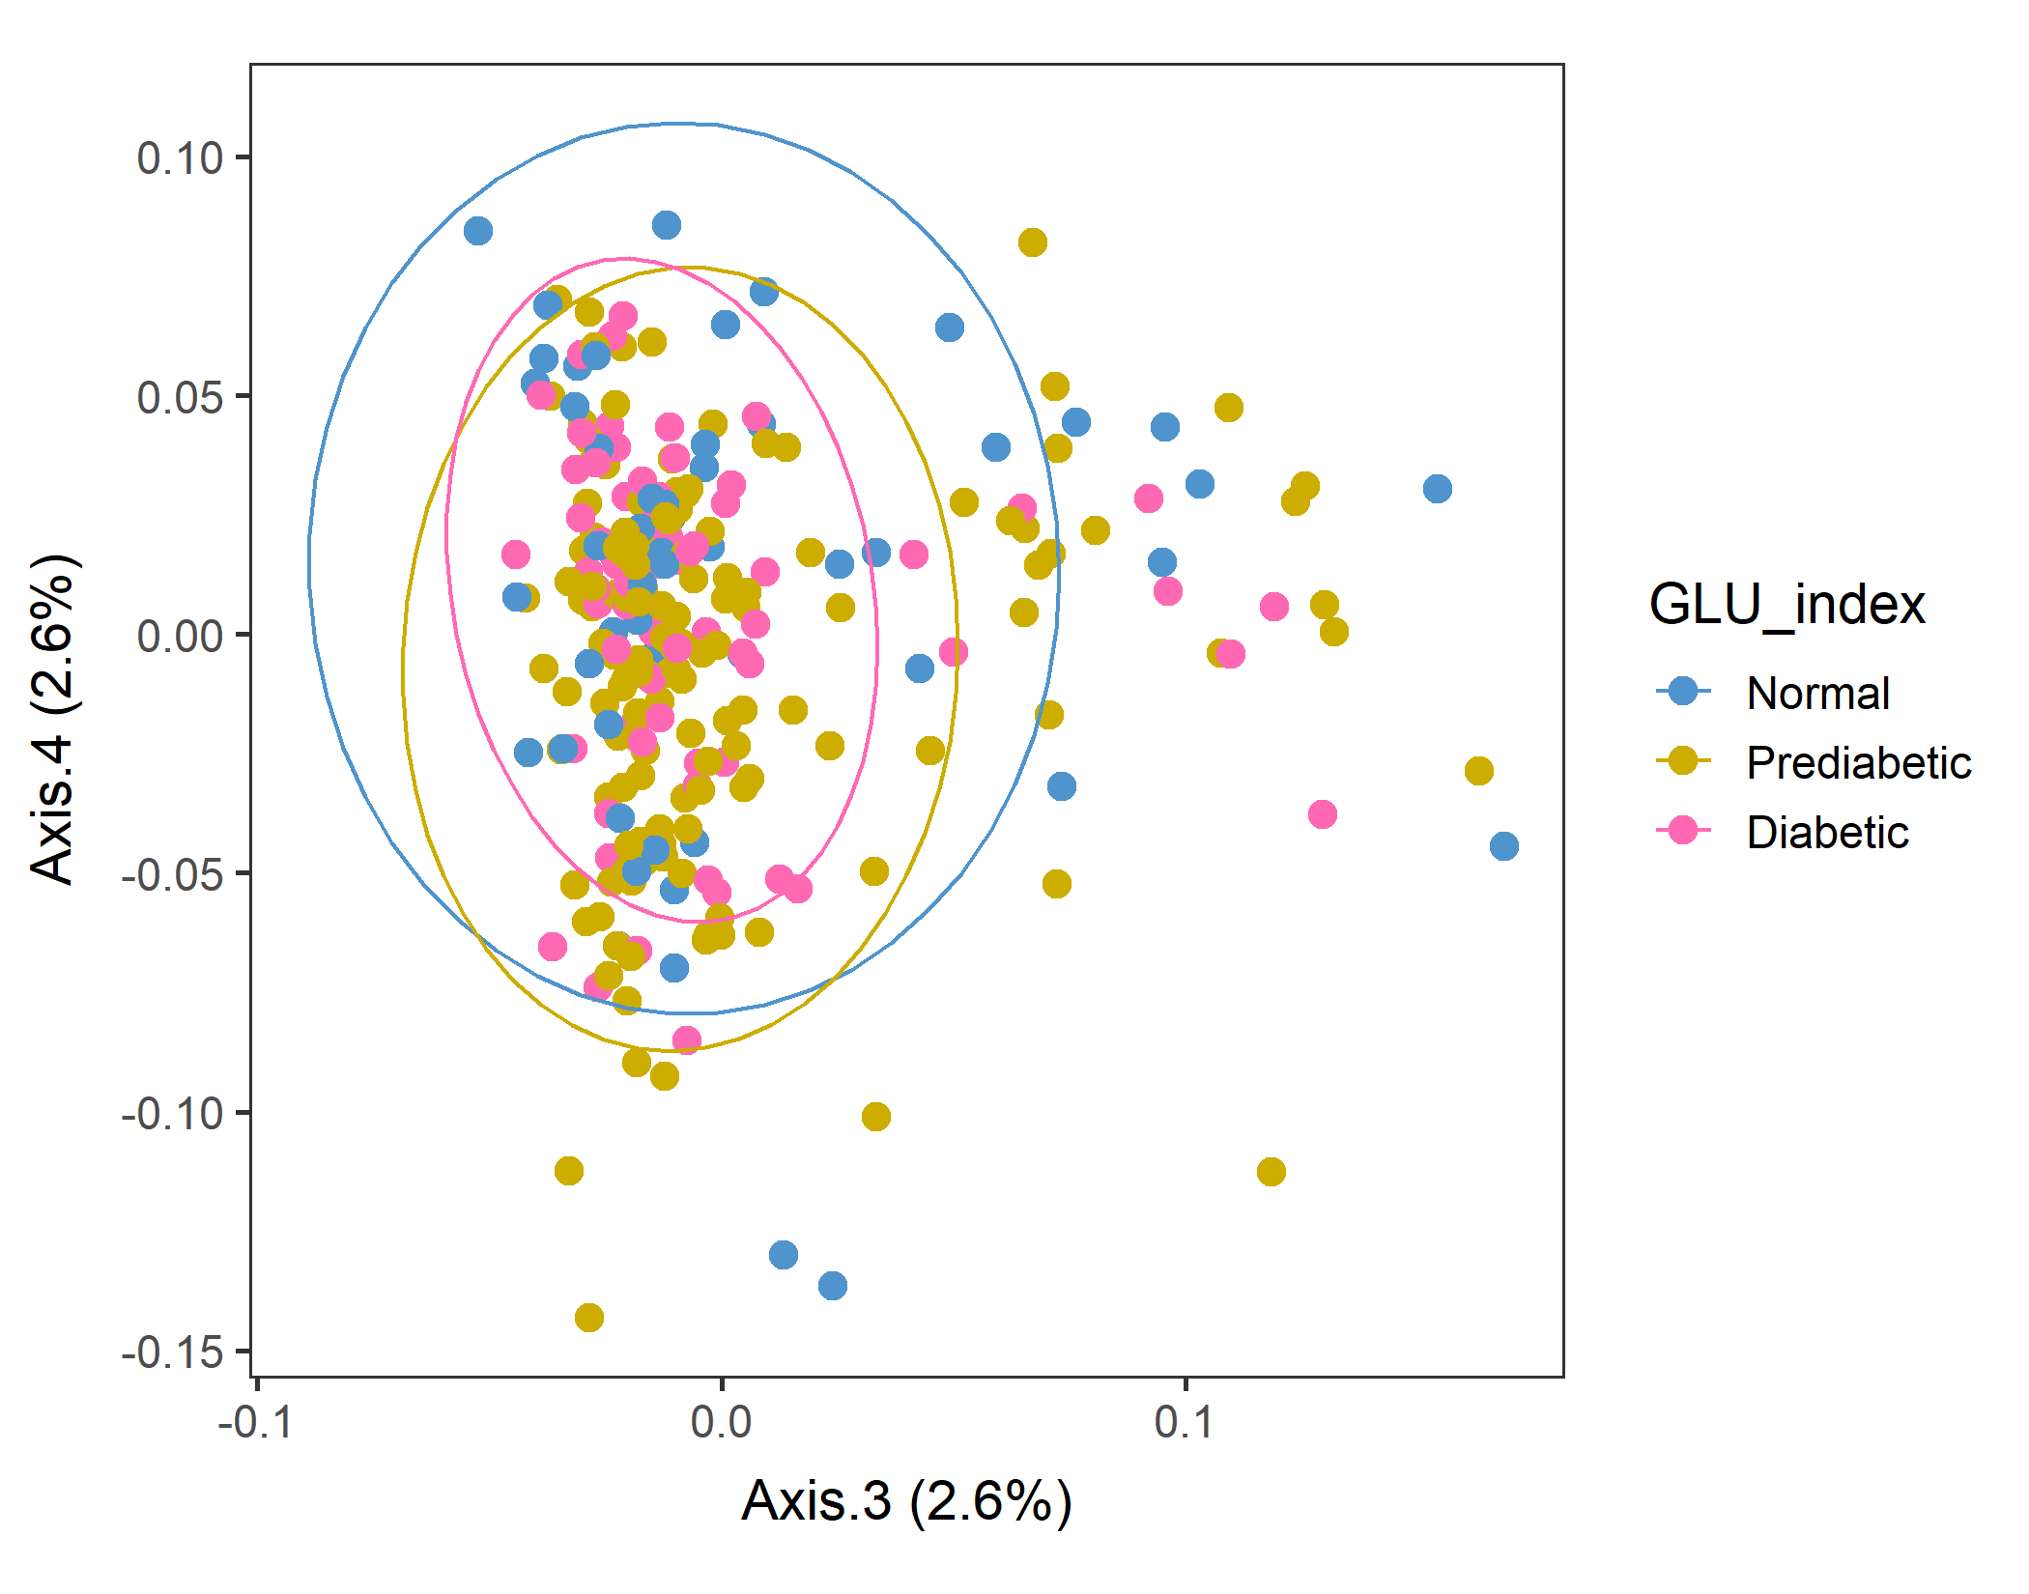
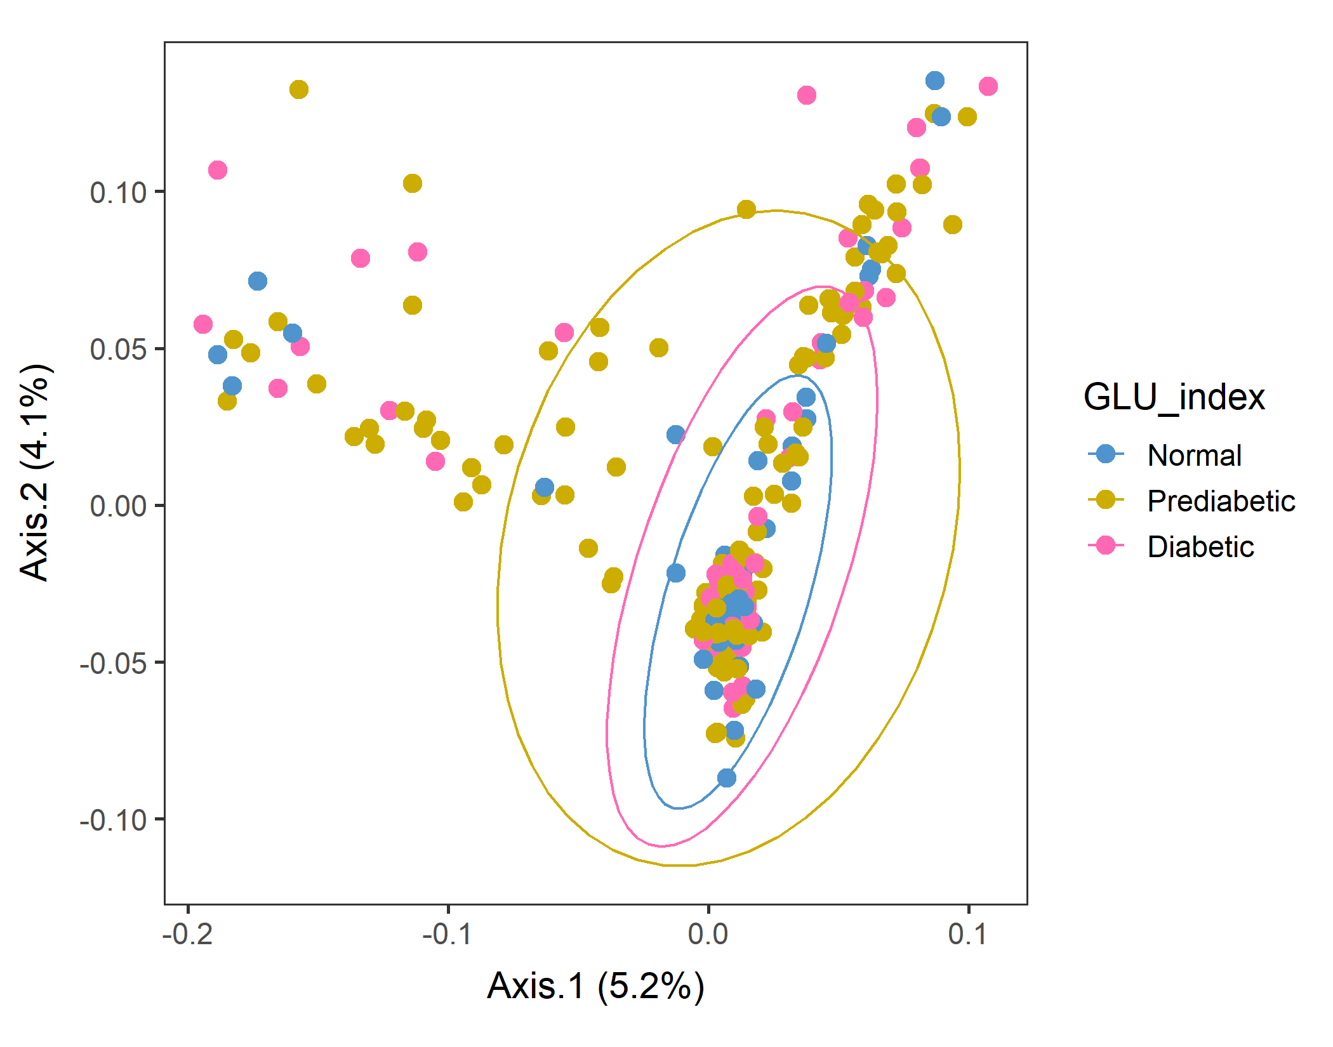
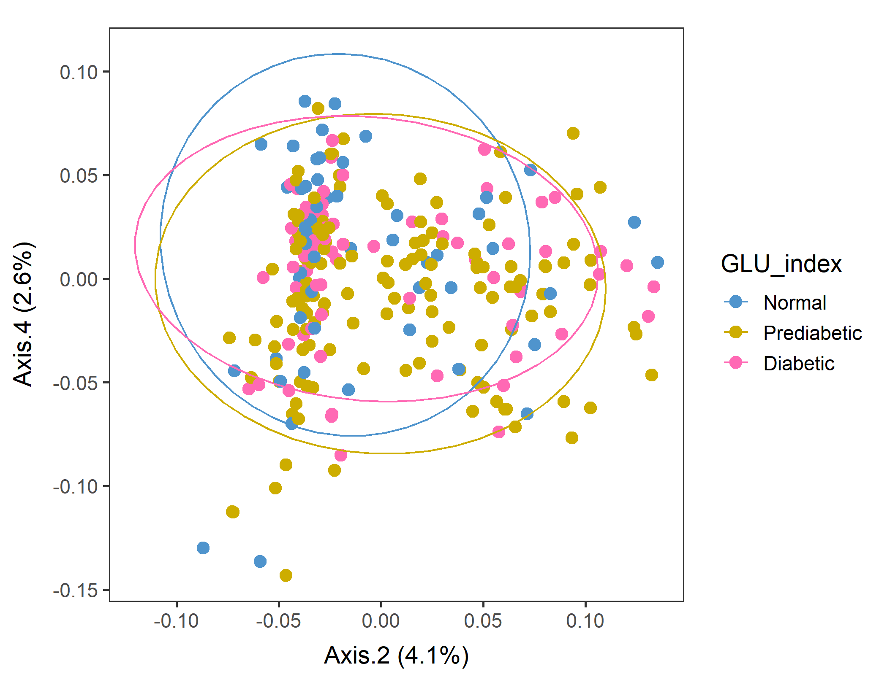
Male in 60plus Lv2 WEIGHTED
In Axes 2&3 and Axes2&4, Normal subpopulations look distinct.
Conversion failed
vegan::permutest: p-value ~0.15. Assumption OK.
vegan::adonis: p-value 0.04. Groups are different.
But pairwise.adonis not significant for any pair.

Slide 9
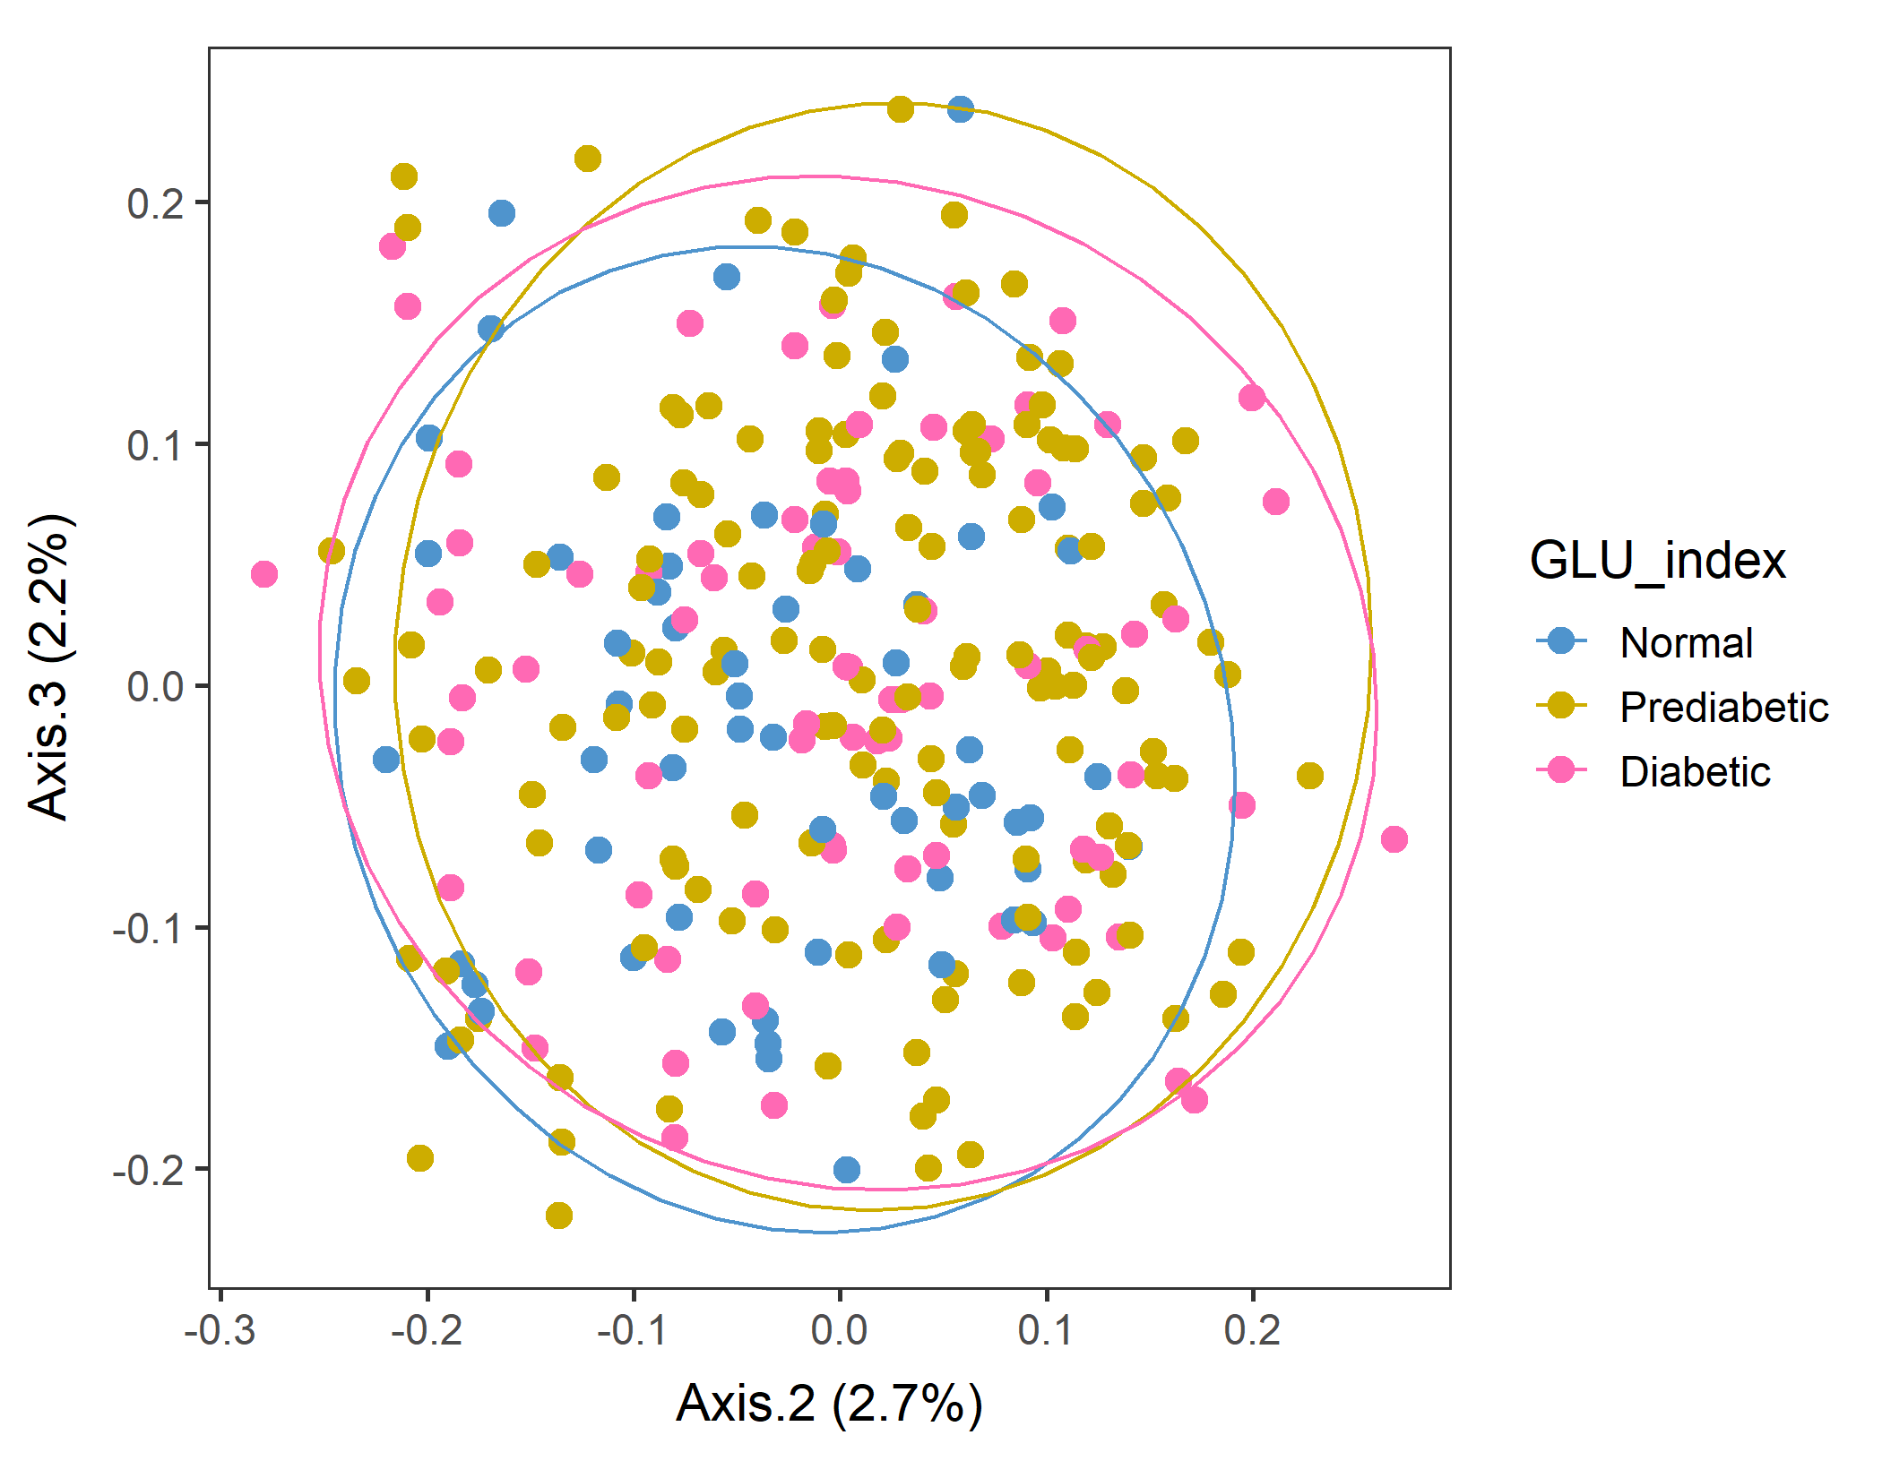
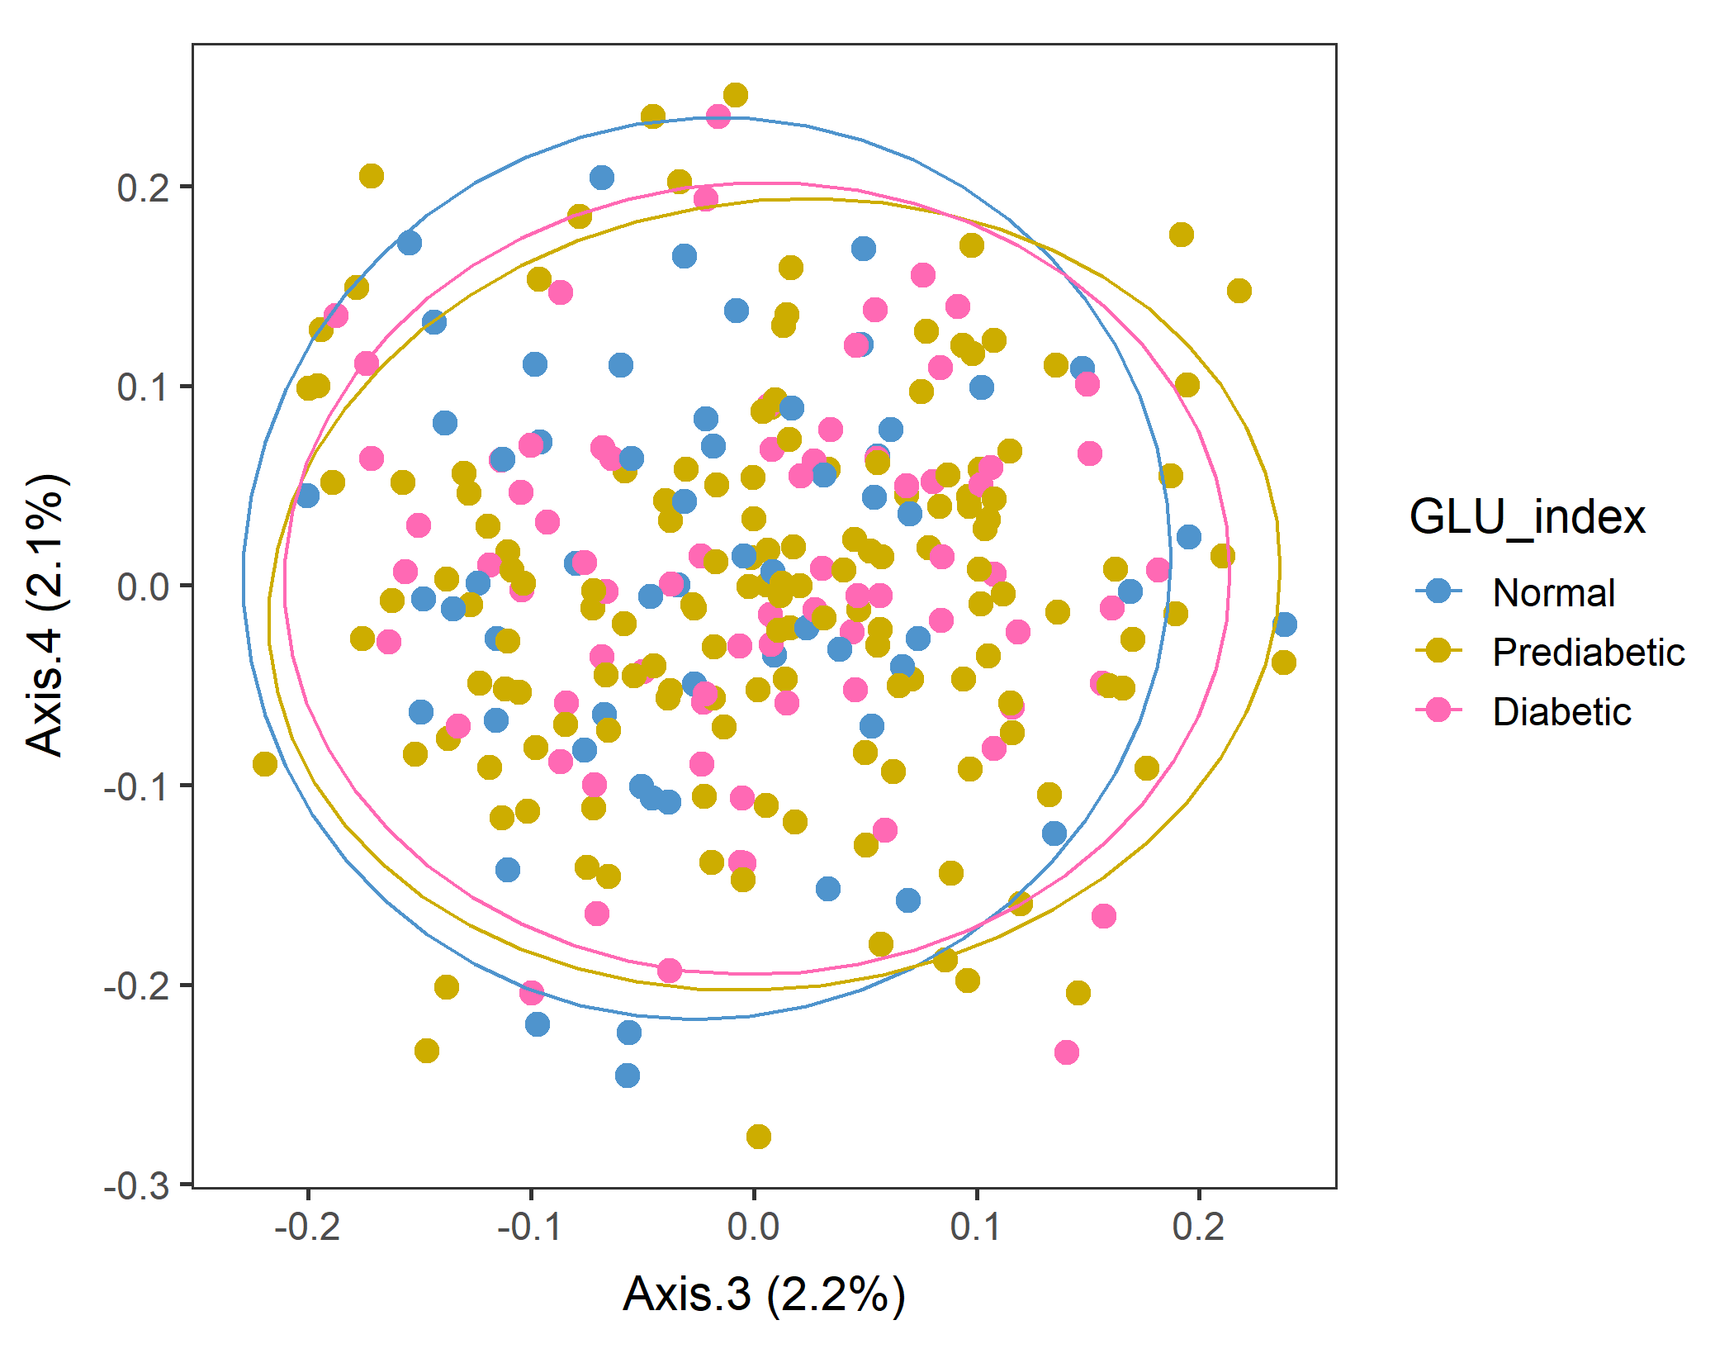
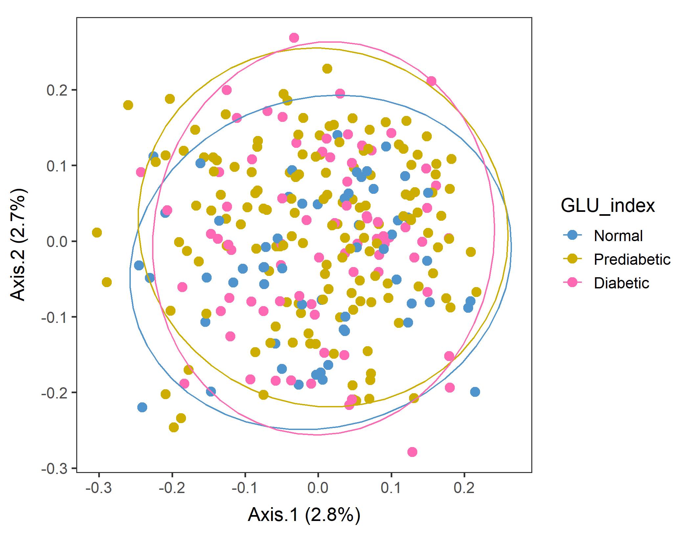
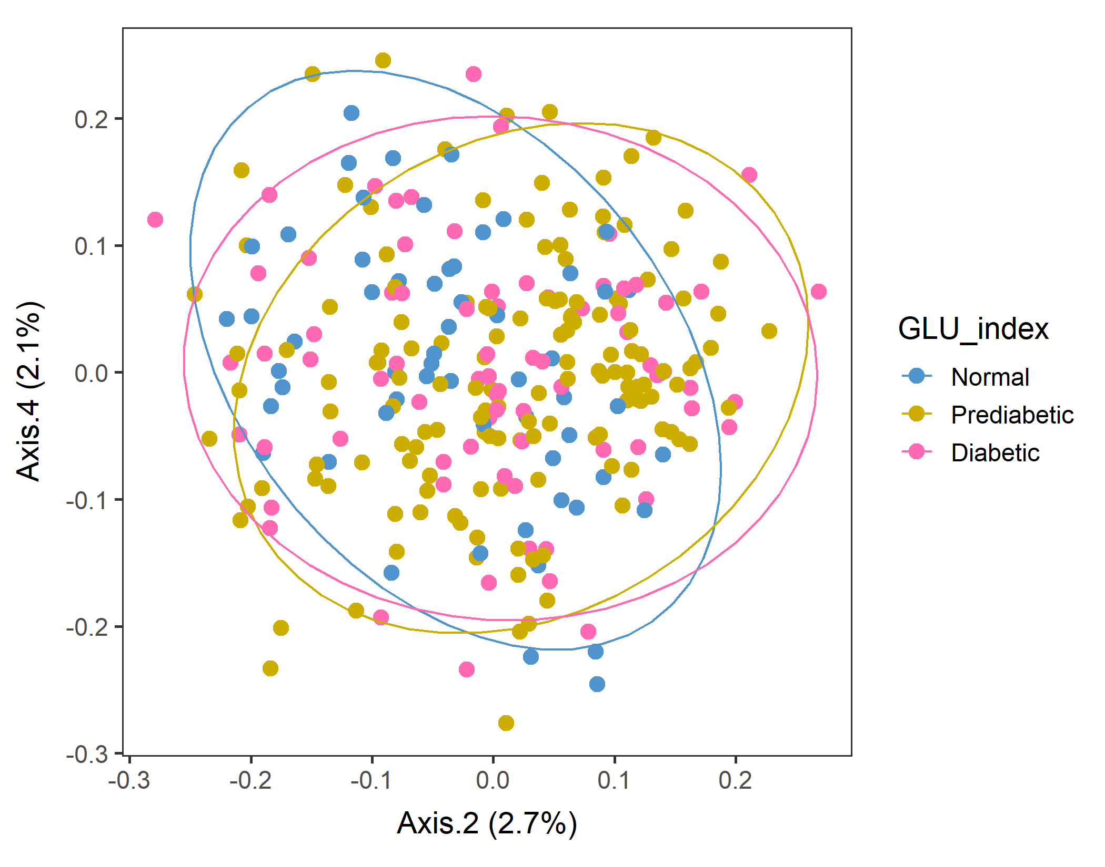
Male in 60plus Lv2 UNweighted
Axes 1&2
vegan::permutest: p-value ~0.8. Assumption OK.
vegan::adonis: p-value:0.013. Groups are different.
But pairwise.adonis not significant for any pair.

Slide 10
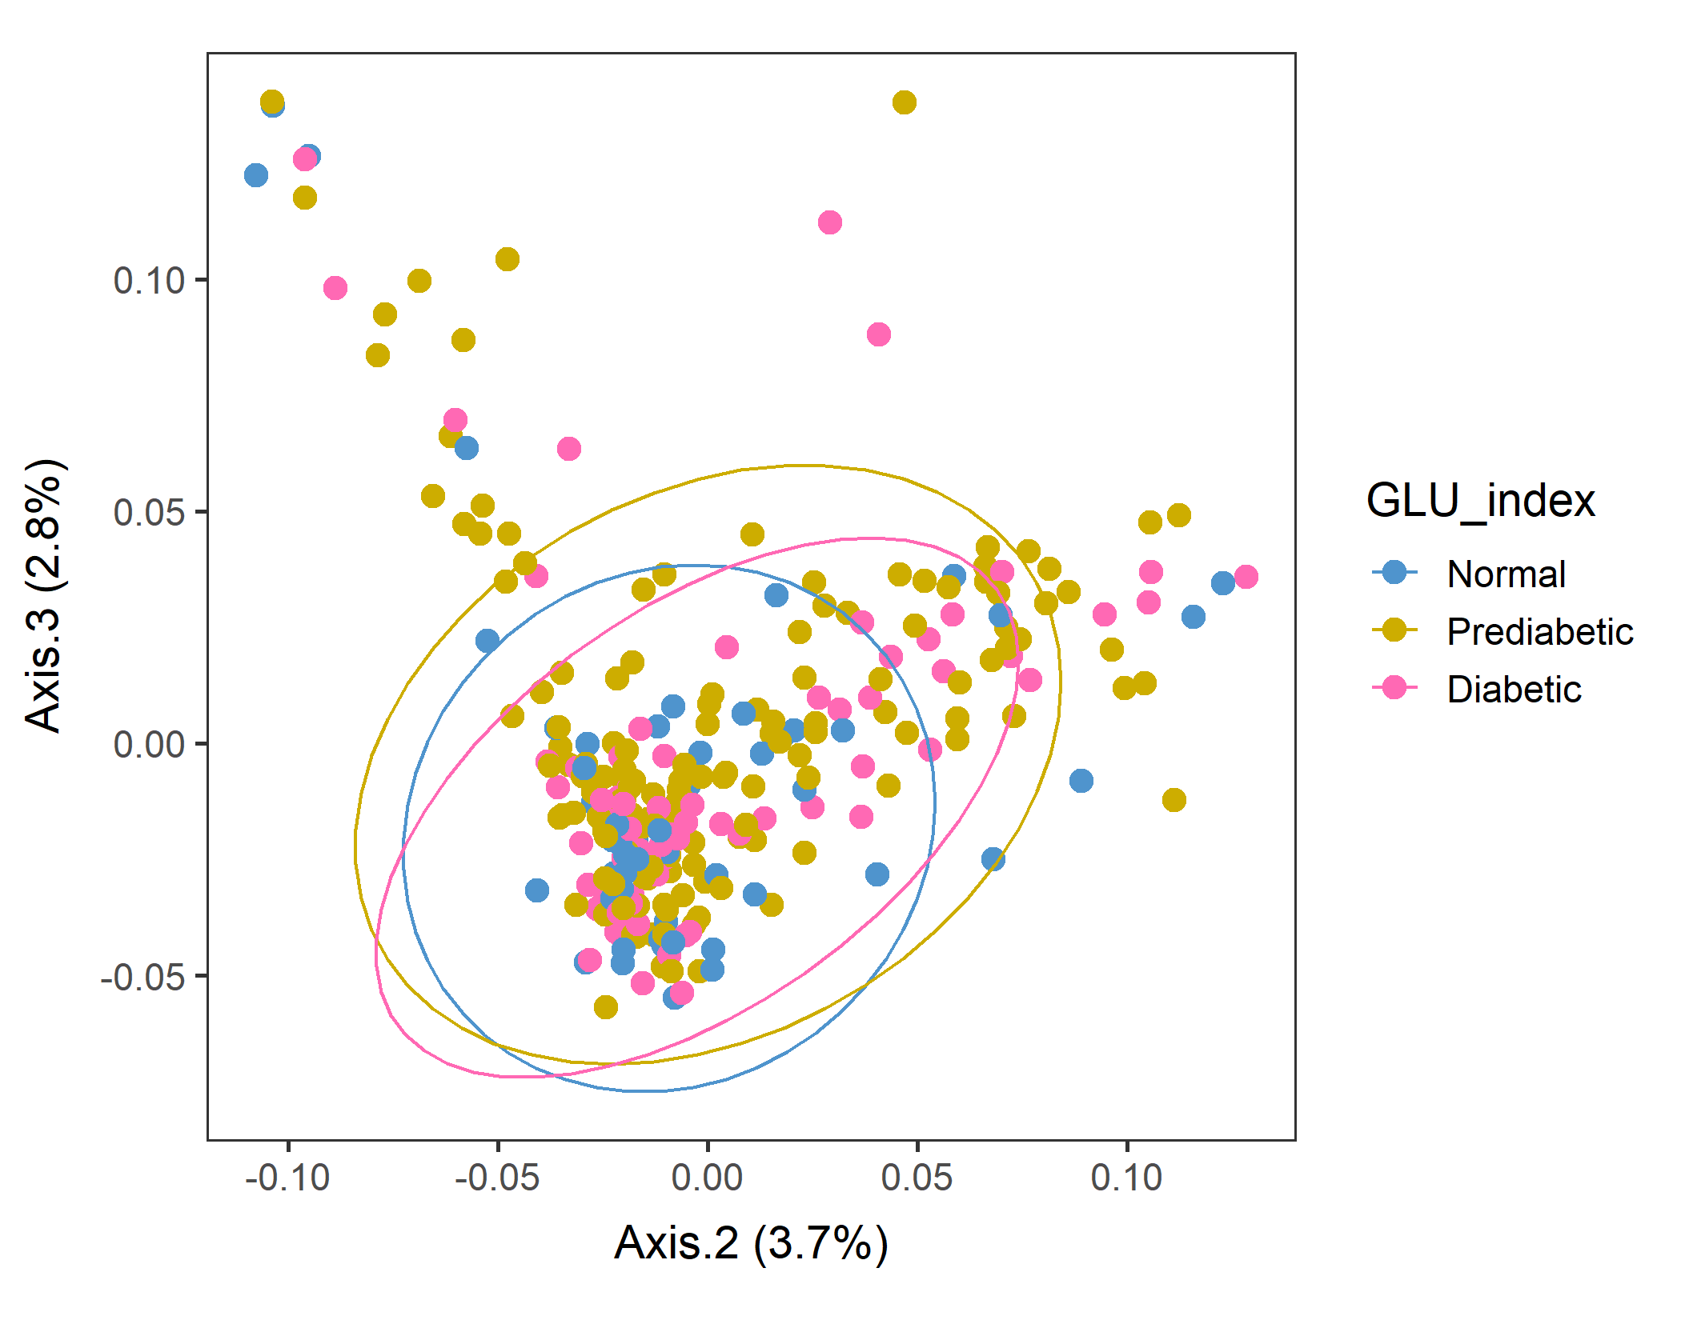
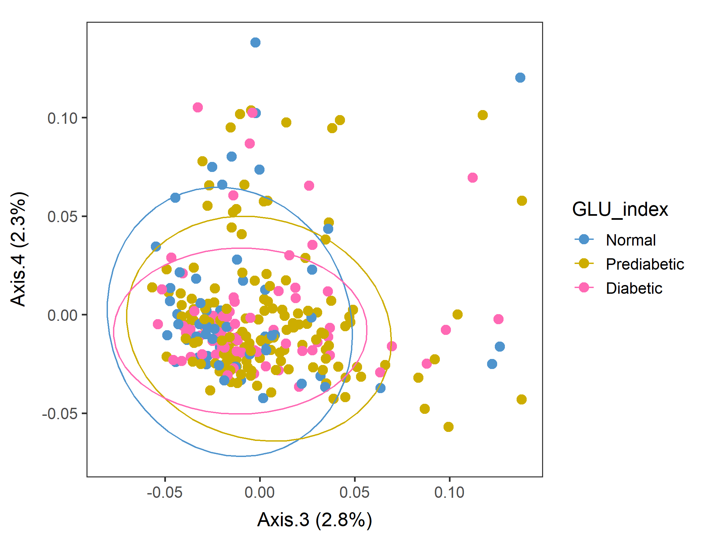
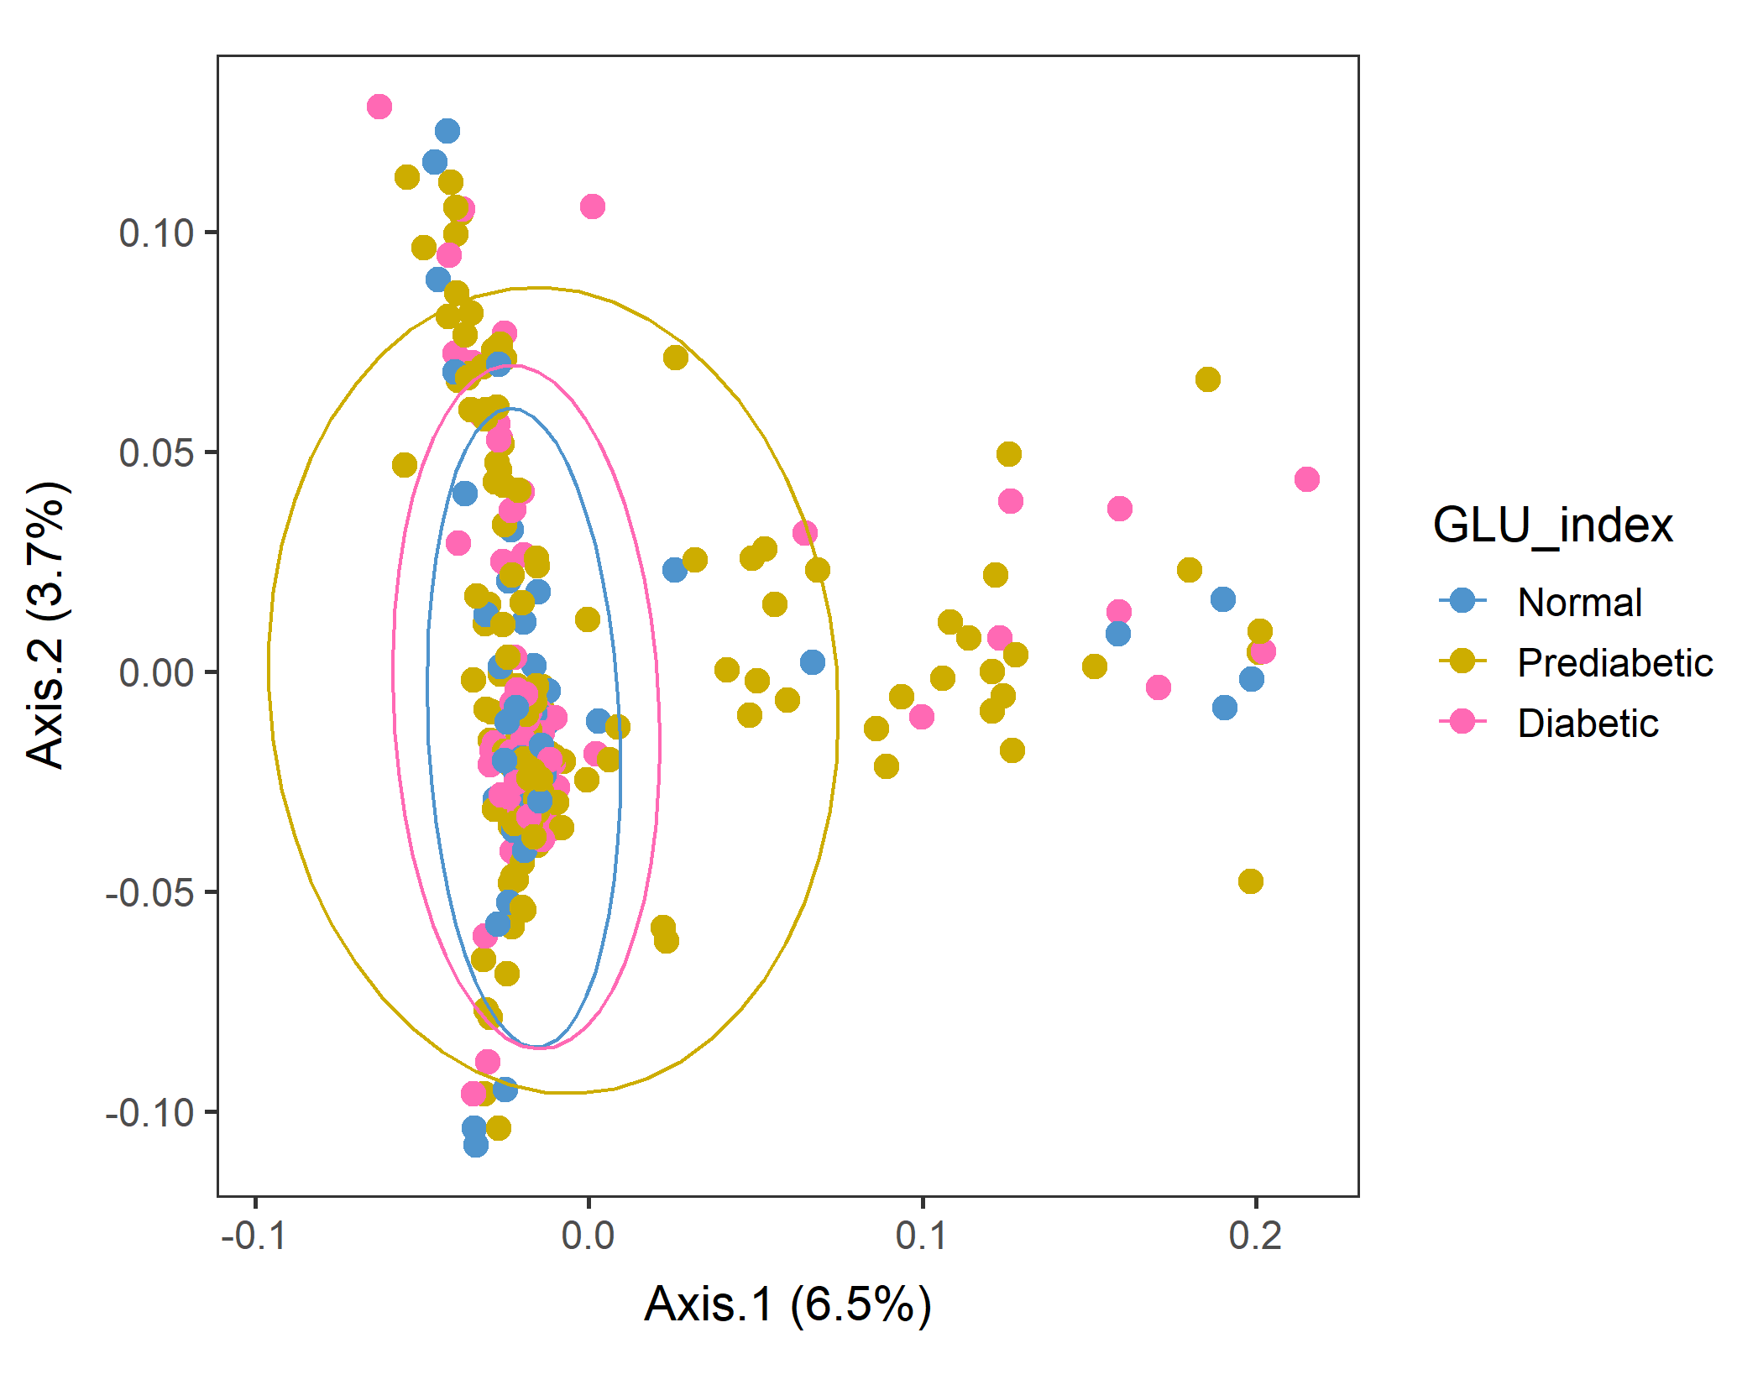
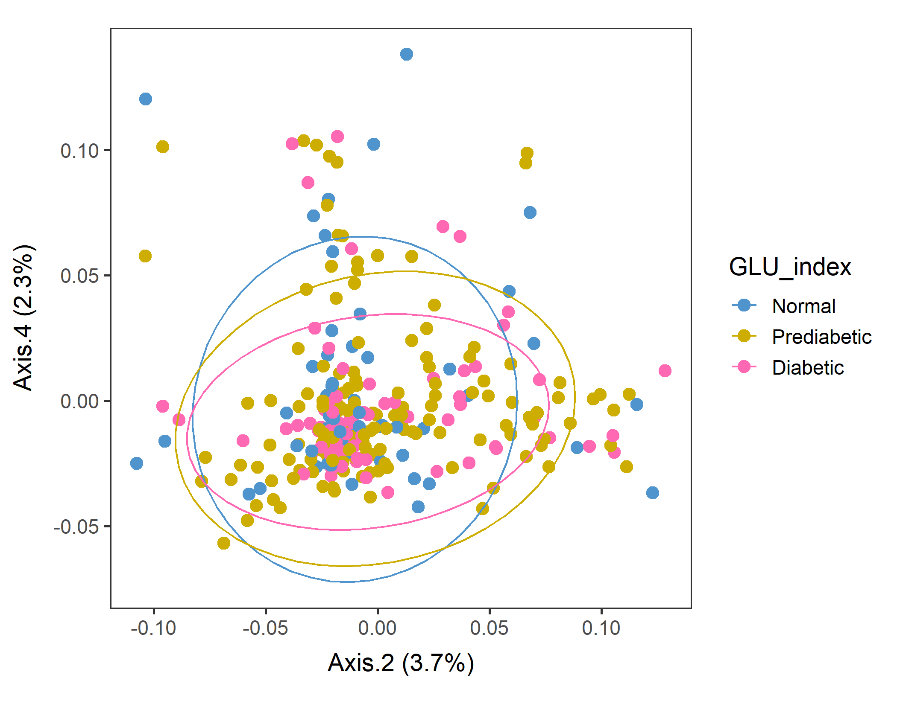
Male in 60plus Lv3 WEIGHTED
Conversion failed
vegan::permutest: p-value ~0.18. Assumption OK.
vegan::adonis: p-value 0.06. Groups are borderline but not different.
Not supposed to do this, but run pairwise adonis (with correct the sample order!). Prediabetic vs Normal are different (p=0.034) but other pairs are not.

Slide 11
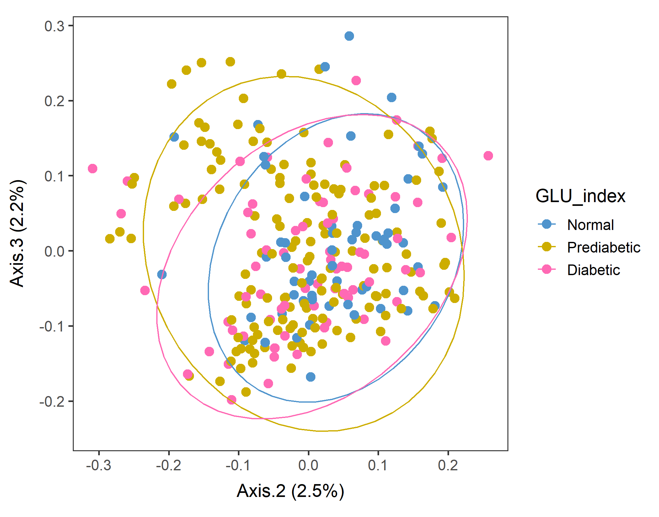
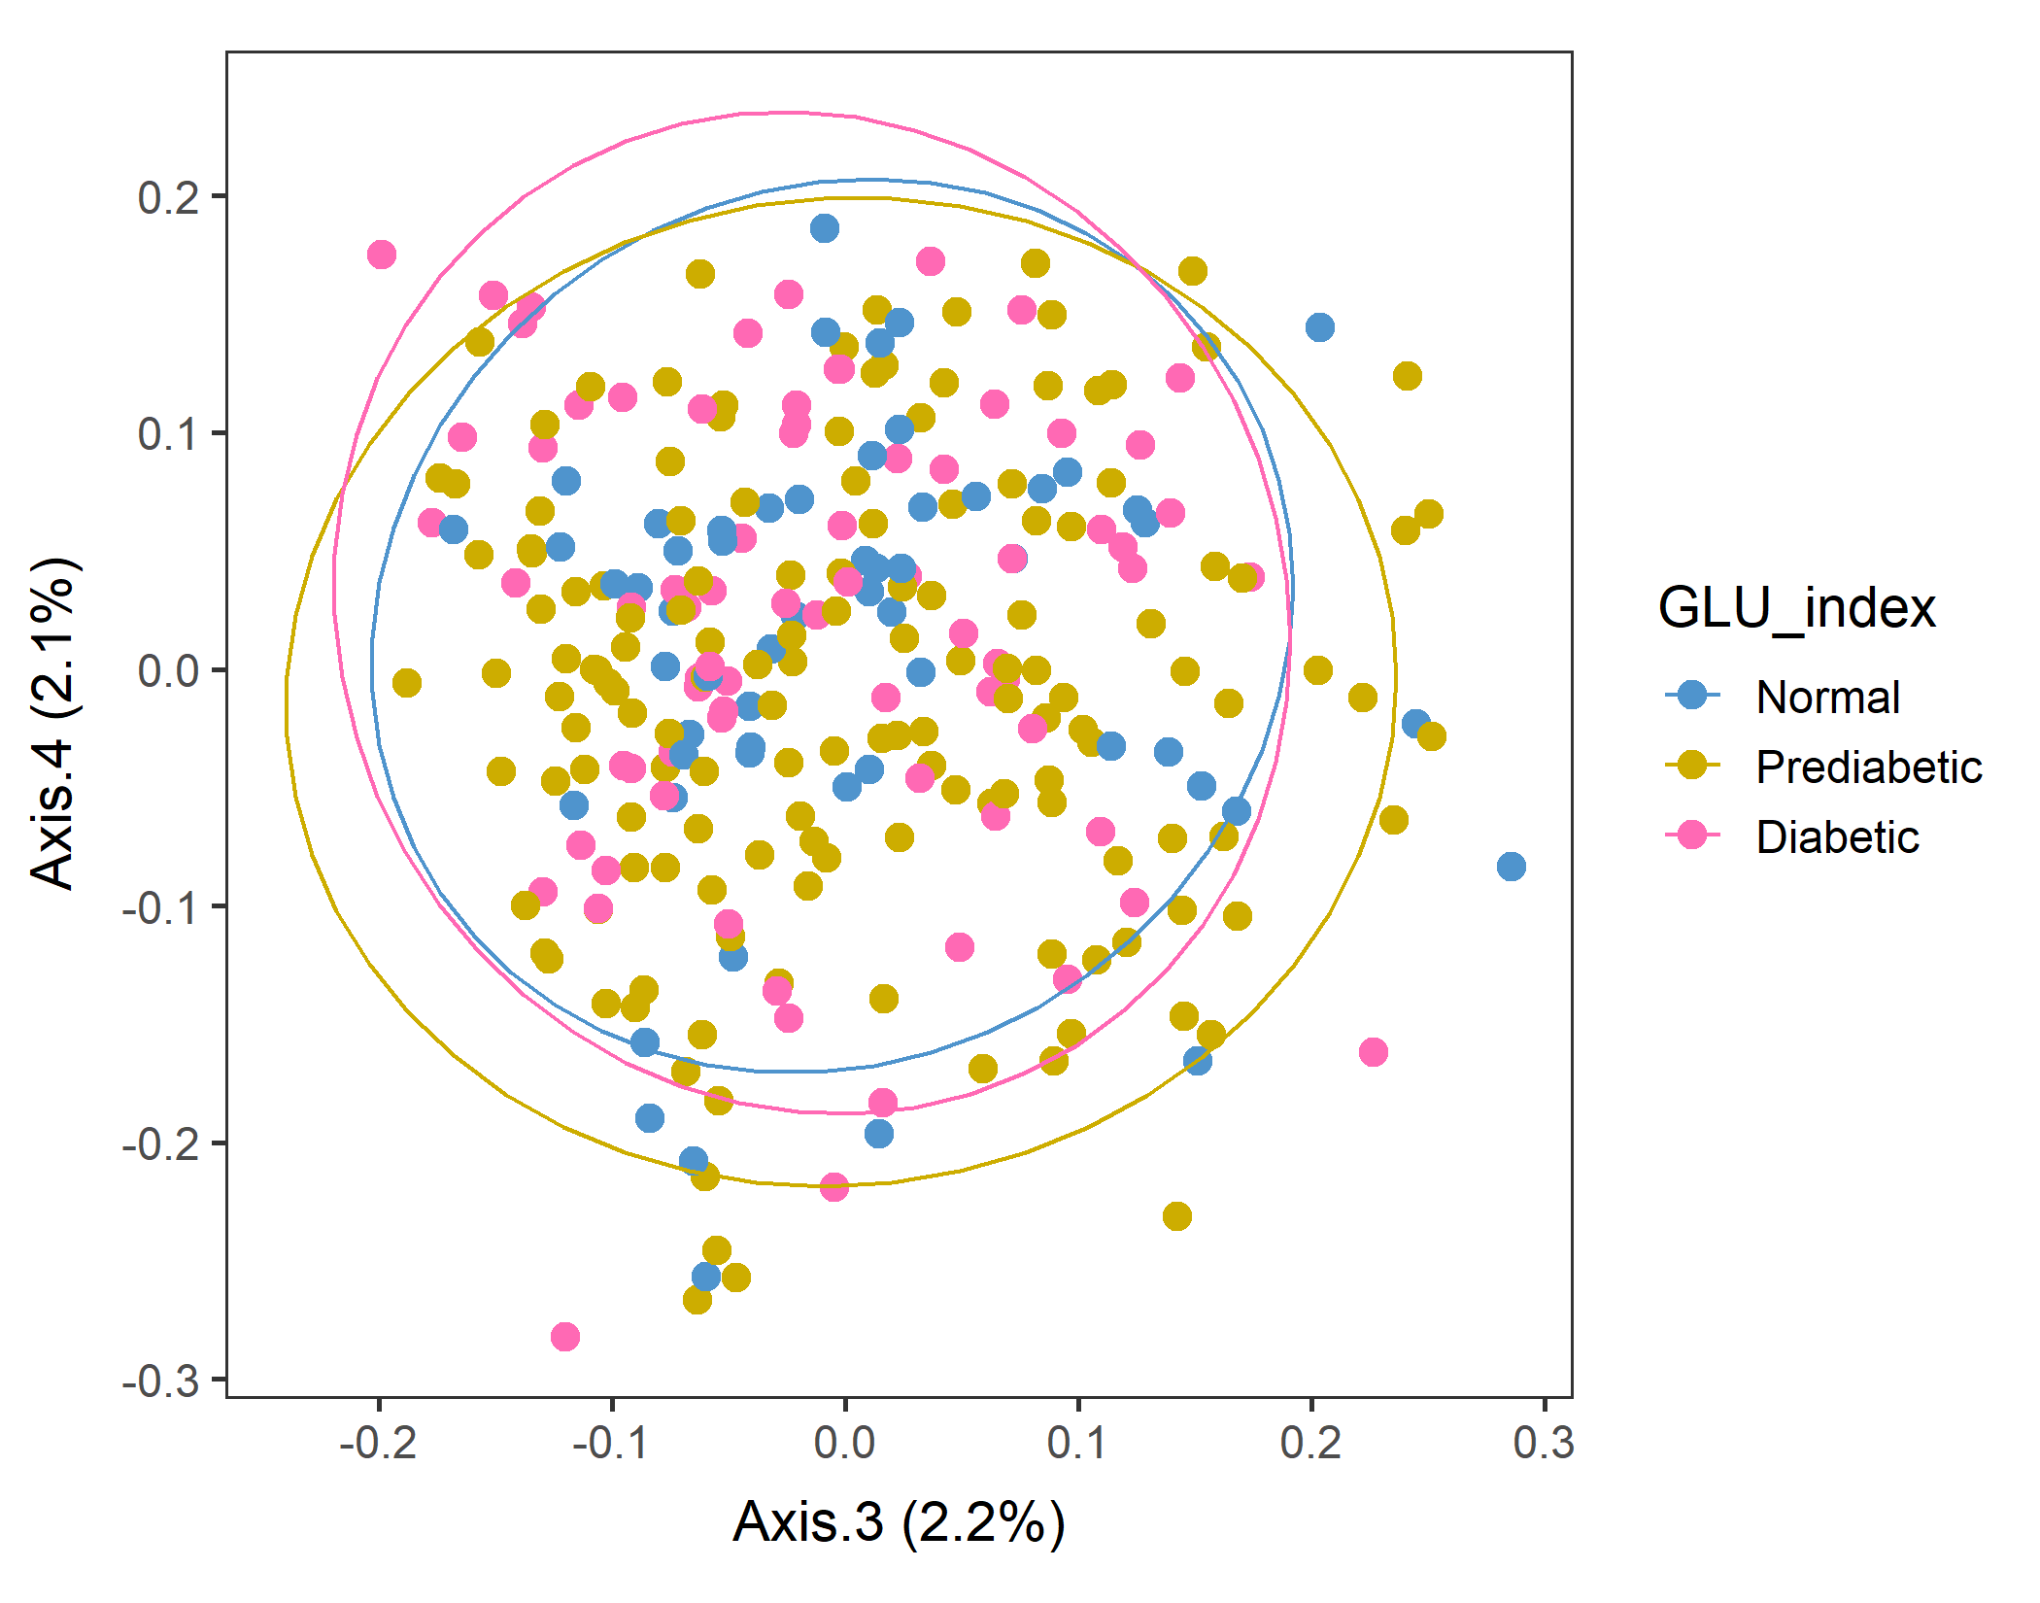
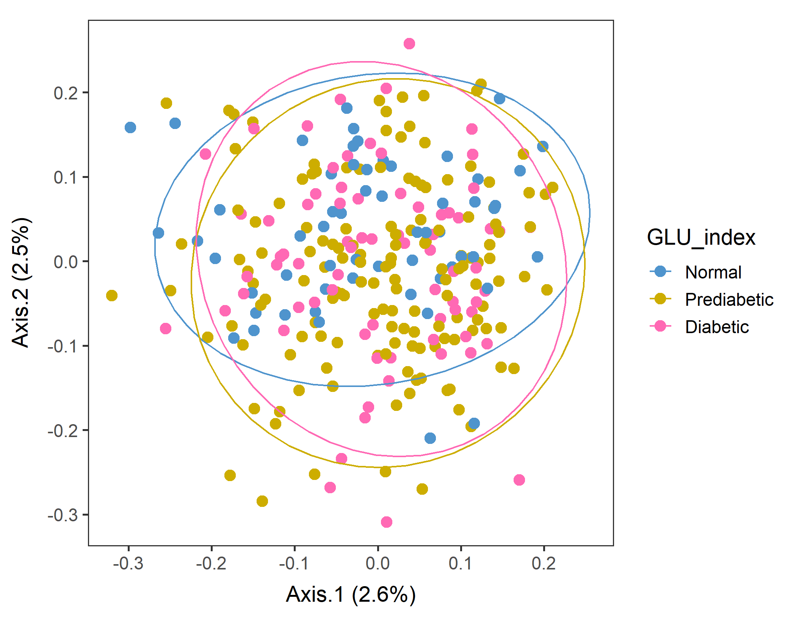
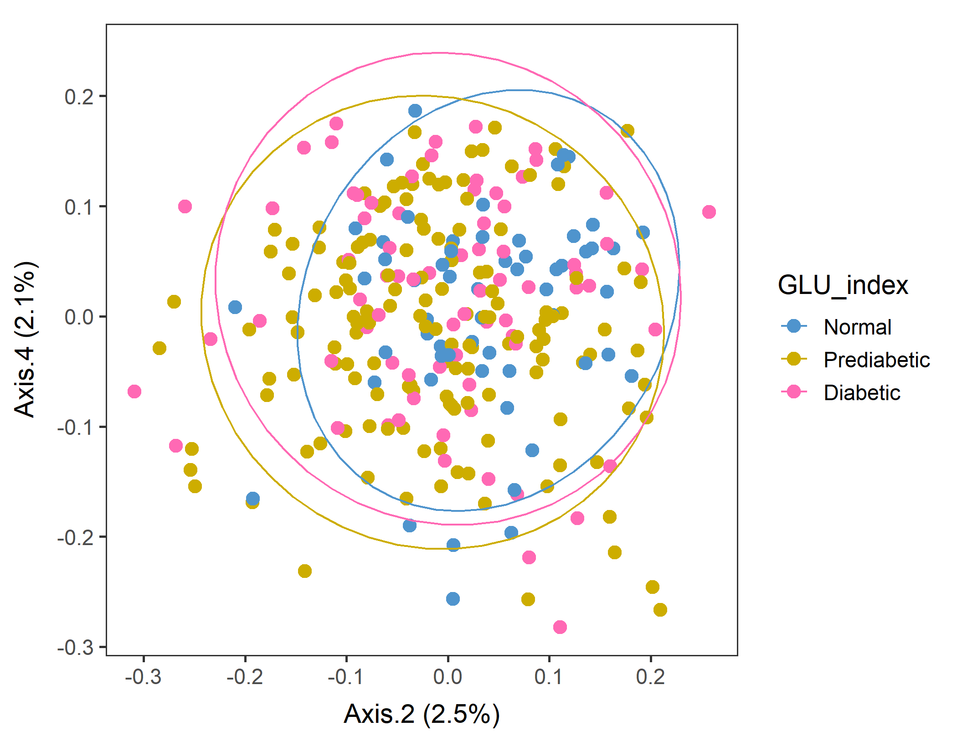
Male in 60plus Lv3 UNweighted
Axes 1&2
vegan::permutest: p-value ~0.86. Assumption OK.
vegan::adonis: p-value:0.007. Groups are different.
Run pairwise adonis (with correct the sample order!). Prediabetic vs Normal are different (p=0.006) but other pairs are not.

Slide 12
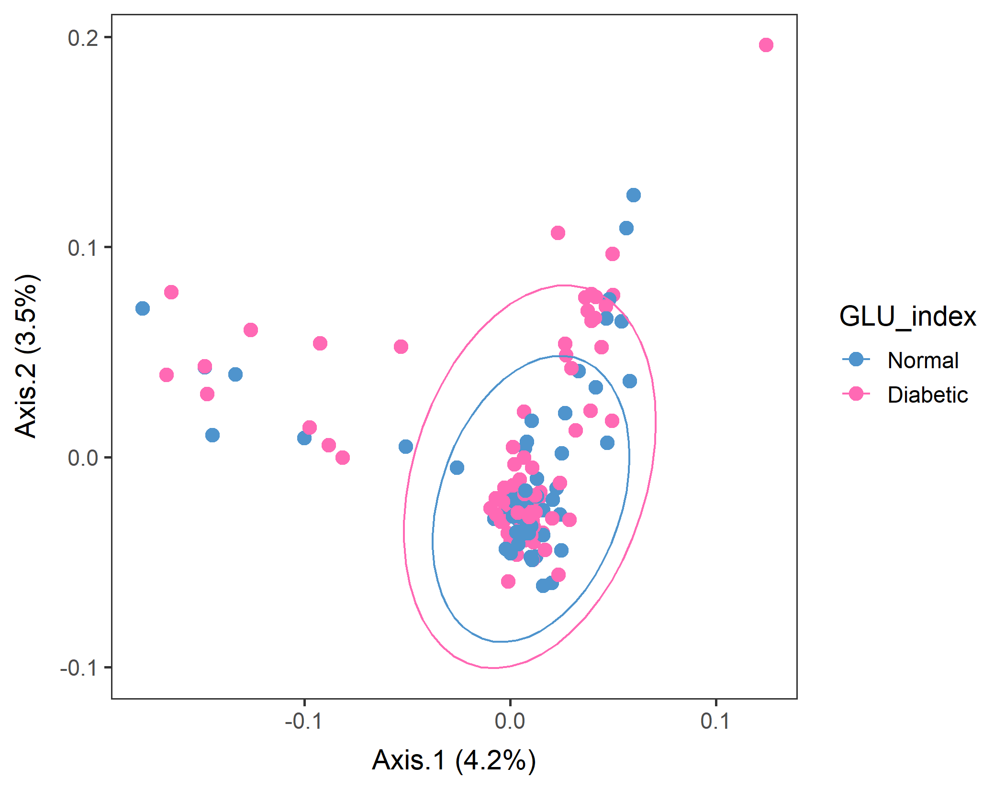
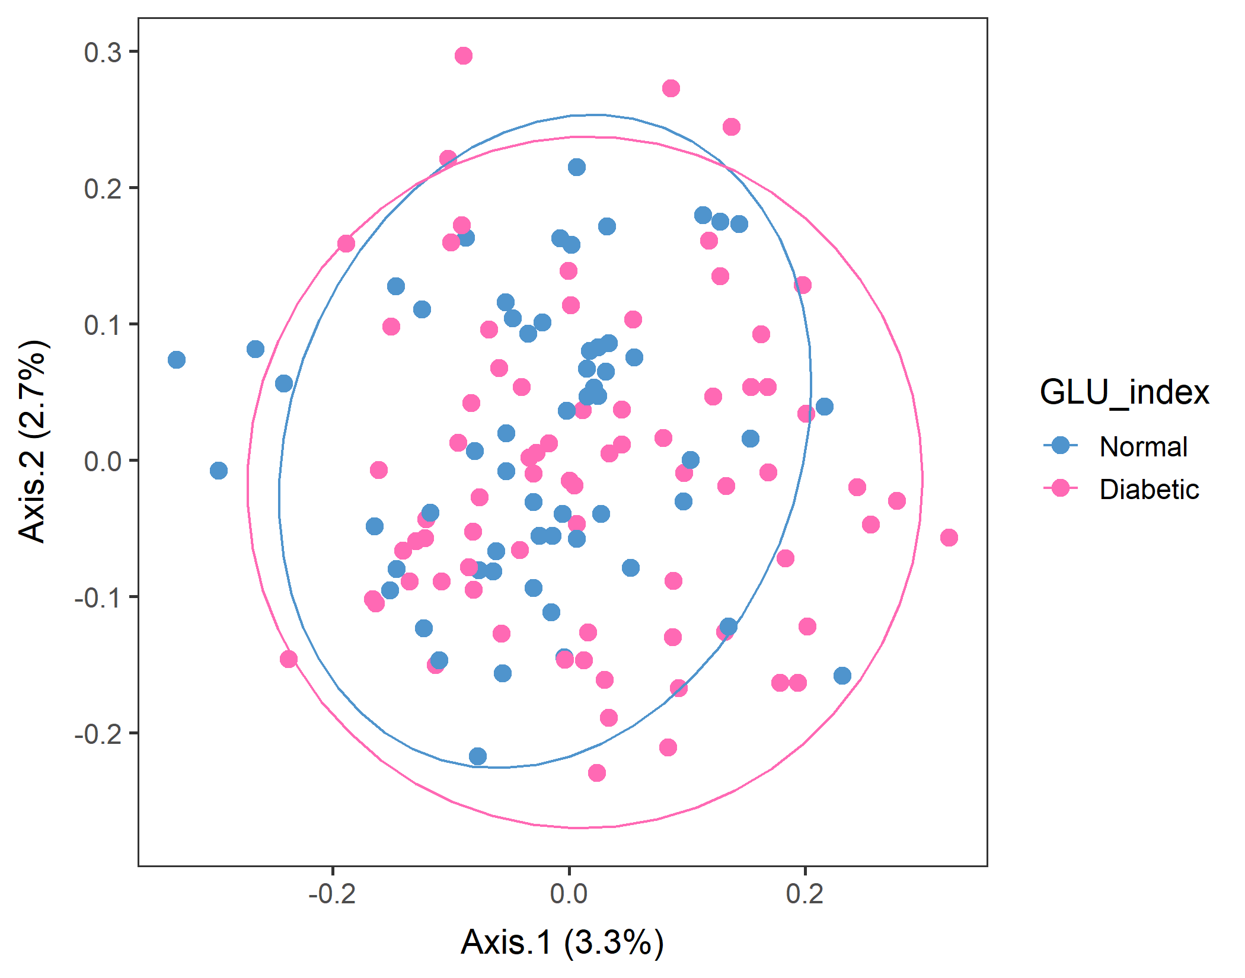
If you subset only Normal and Diabetic, is there a difference between them?
WEIGHTED
vegan::permutest: p-value ~0.15. Assumption OK.
vegan::adonis: p-value: 0.06. Groups are still borderline..
Pairwise adonis should return the same results as overall adonis because there are only two groups. And it did with a similar p-value.
UNweighted
vegan::permutest: p-value ~0.6. Assumption OK.
vegan::adonis: p-value:0.04. Groups are different..
Pairwise adonis should return the same results as overall adonis because there are only two groups. And it did with a similar p-value.
Should look at Normal vs. Prediabetic.

Slide 13
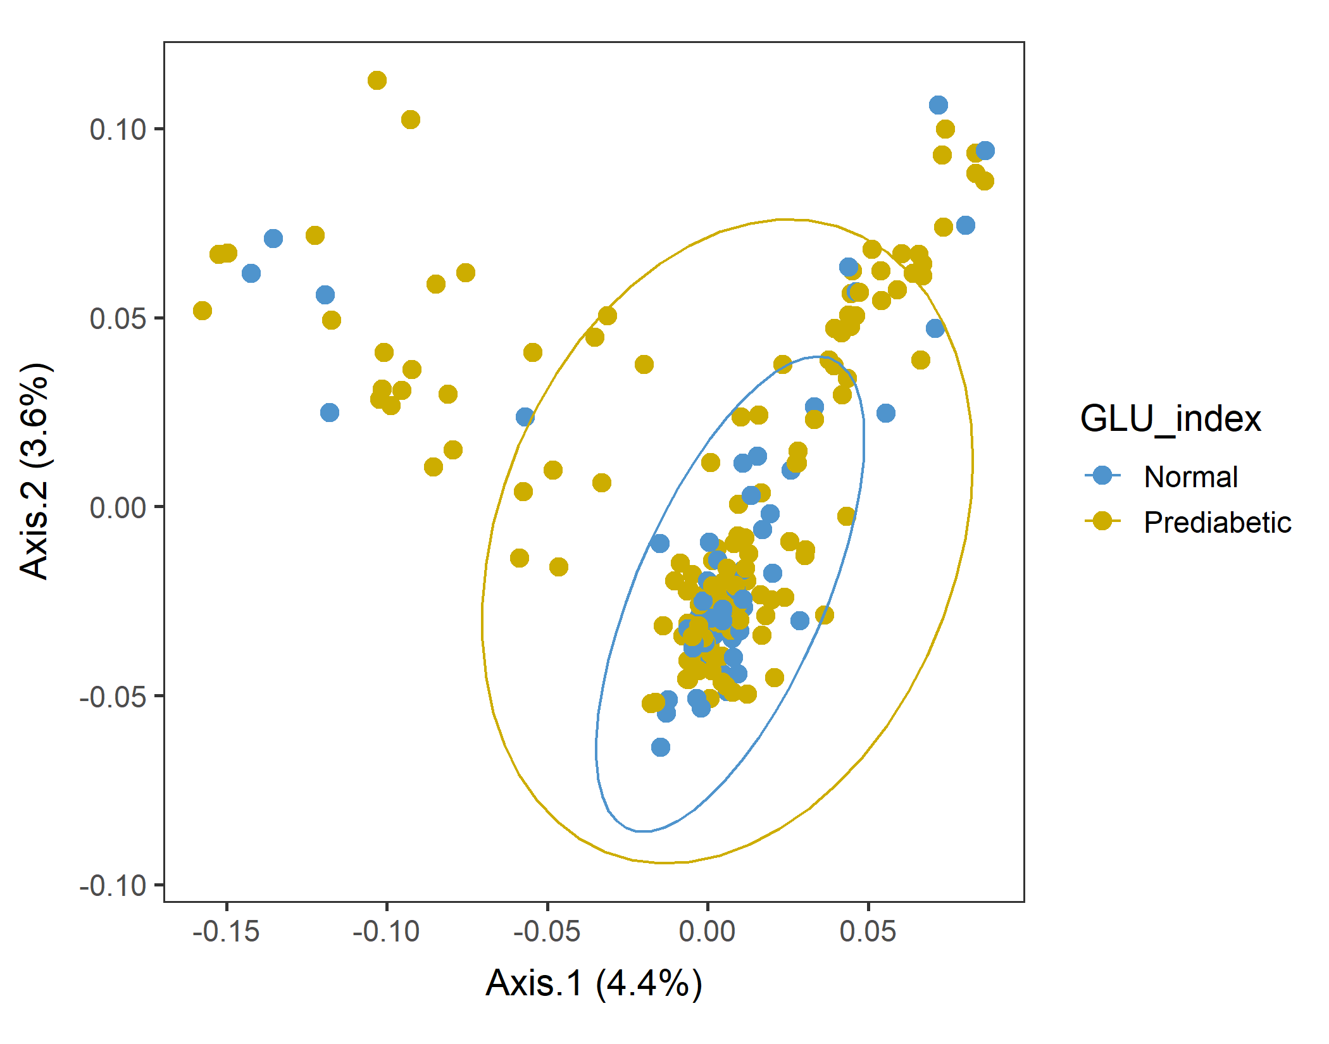
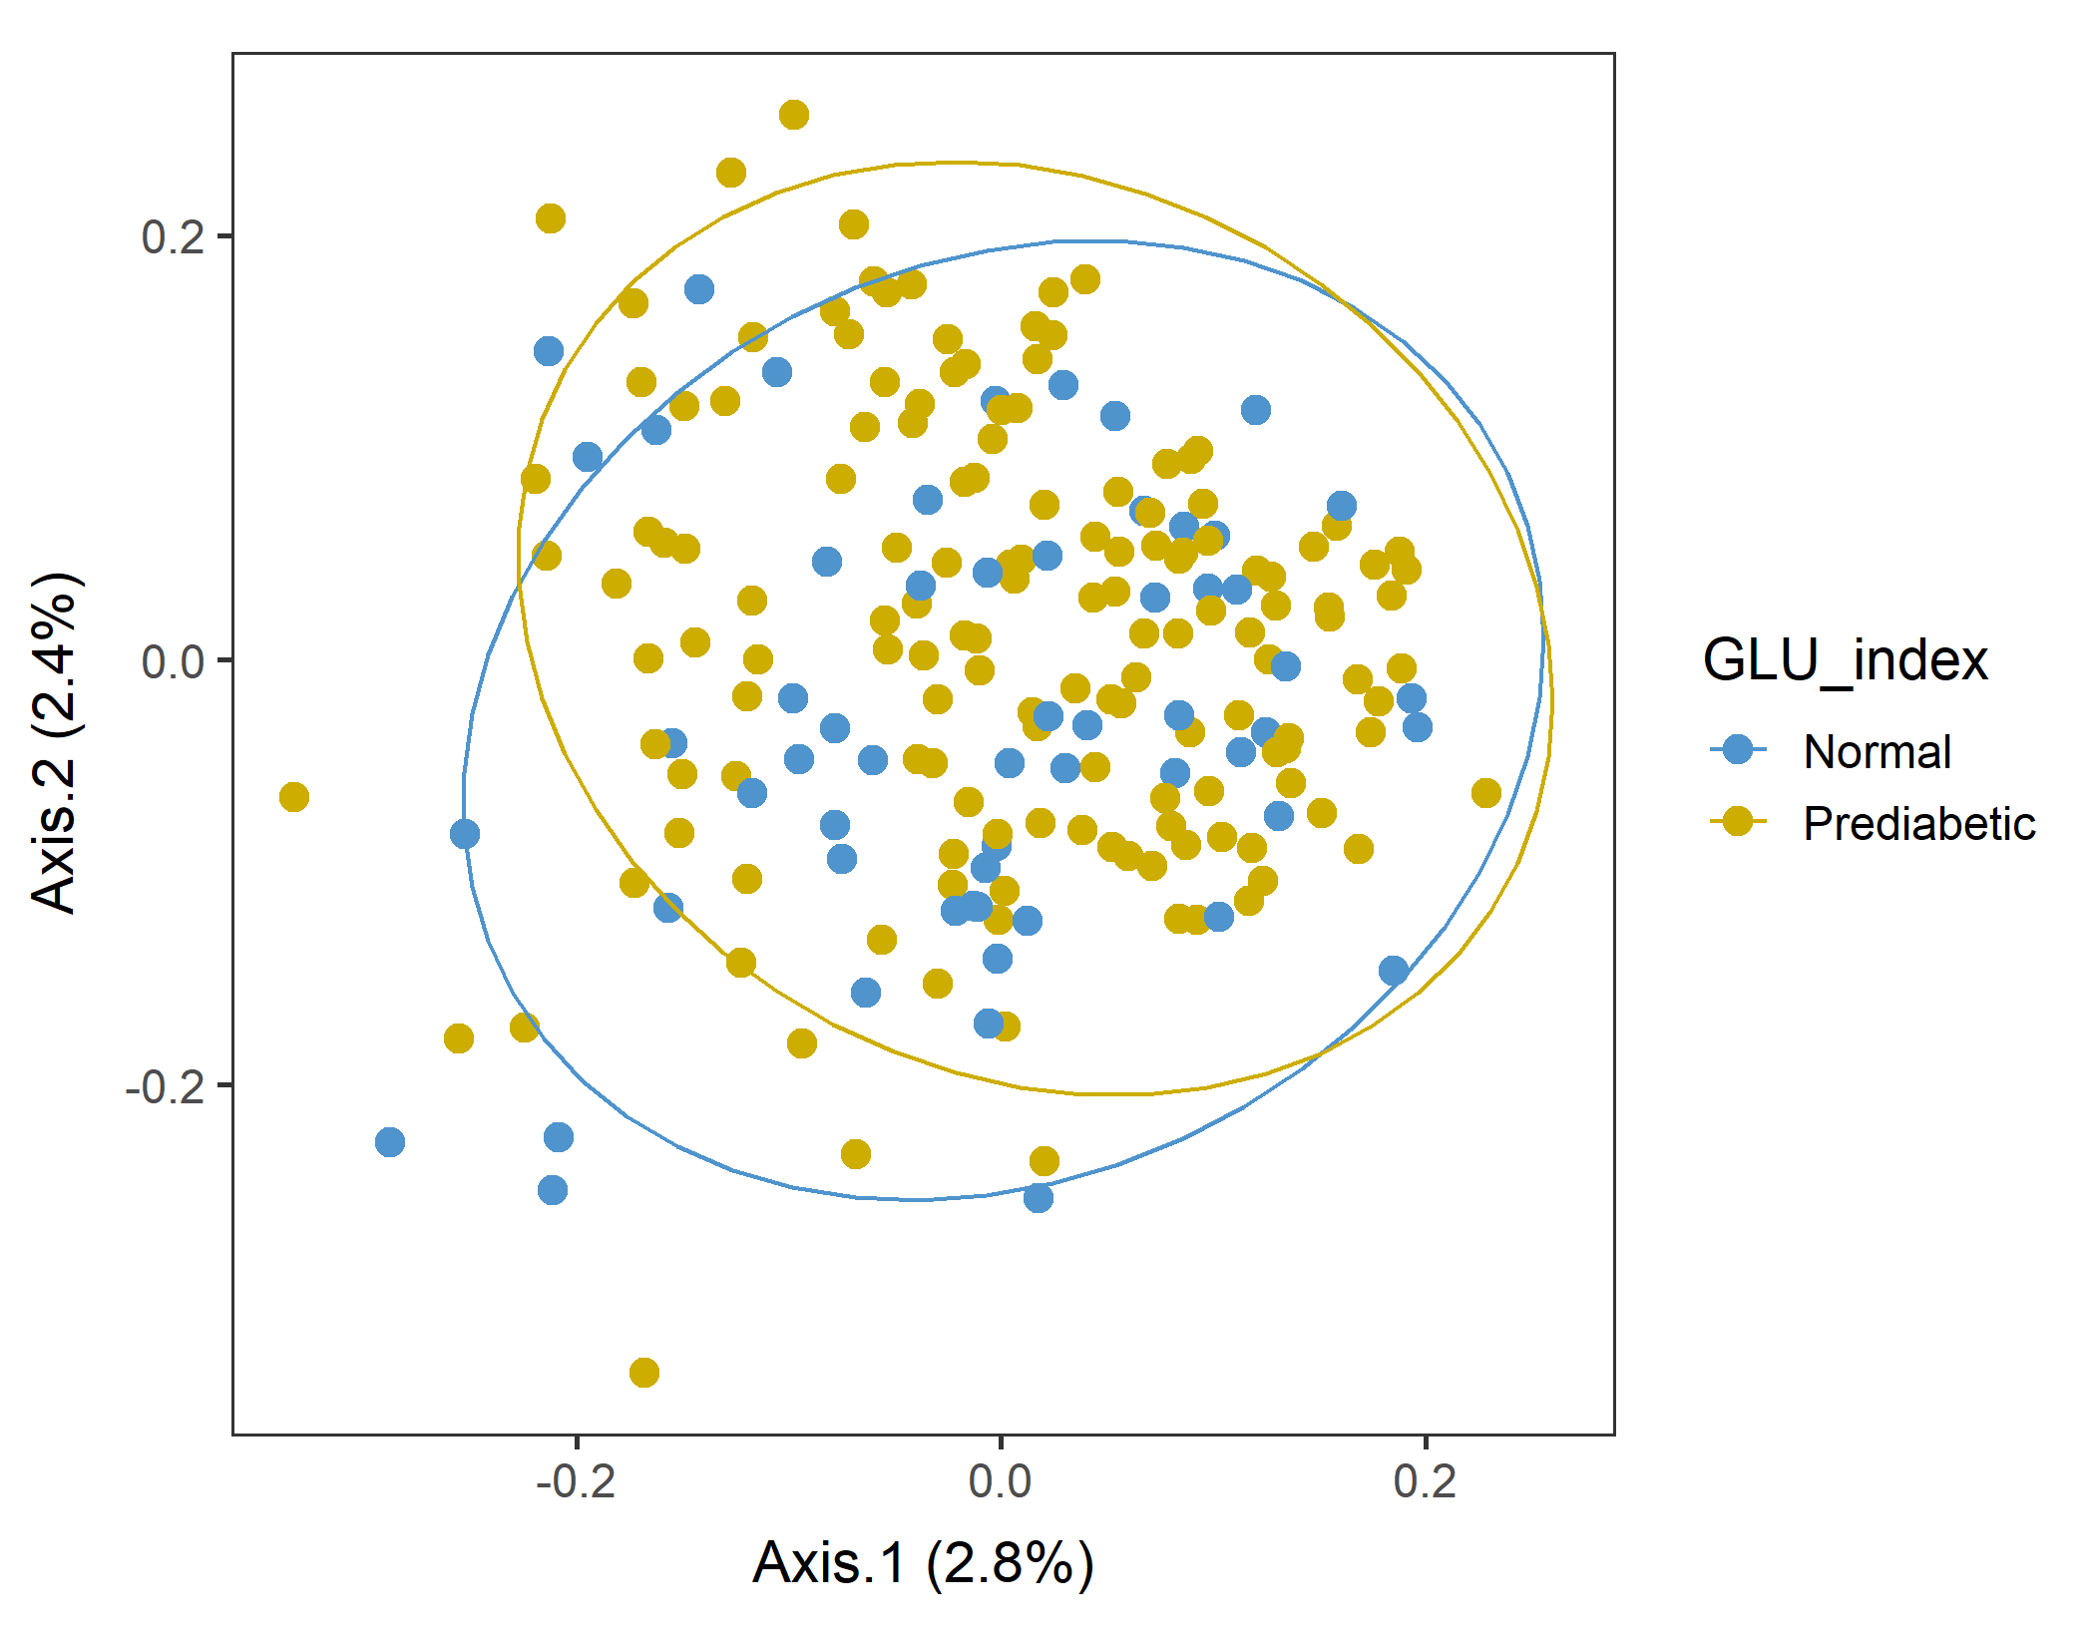
If you subset only Normal and Prediabetic, is there a difference between them?
WEIGHTED
vegan::permutest: p-value ~0.5. Assumption OK.
vegan::adonis: p-value: 0.02. Groups are different, as expected.
Pairwise adonis should return the same results as overall adonis because there are only two groups. And it did with a similar p-value.
UNweighted
vegan::permutest: p-value ~0.77. Assumption OK.
vegan::adonis: p-value: ~0.01. Groups are different.
Pairwise adonis should return the same results as overall adonis because there are only two groups. And it did with a similar p-value.
Yes, they are different!

Slide 14
Ordination with an Euclidean distance matrix
.

Slide 15
Male in 60plus test separation using adonis by feeding Euclidean distance matrix to the model.
dist_matrix_e <- dist(as.data.frame(t(food2)), method = "euclidean", diag = T)
vegan::adonis(DISTANCE_MATRIX, FACTOR, perm=999)
In theory, it can handle any distance matrix, even Euclidean.
vegan::permutest: p-value ~0.9. Assumption OK.
vegan::adonis: p-value”: 0.08. Groups are not different.
Pairwise.adonis: All pairs are not different (p ~0.14).

Slide 16
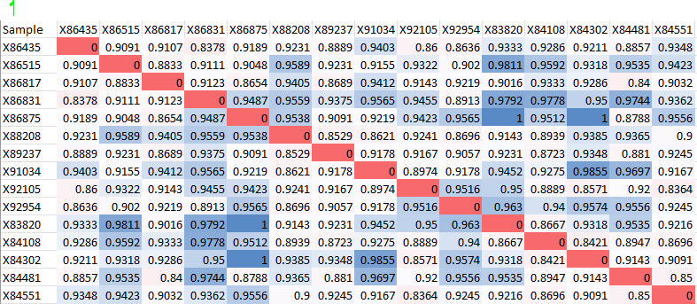
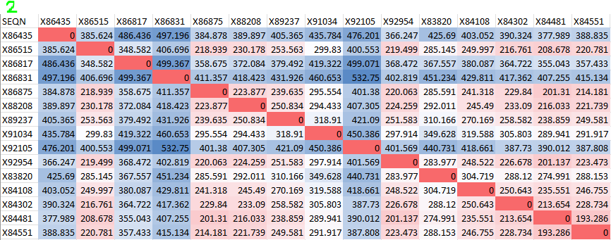
Male in 60plus test separation using adonis by feeding Euclidean distance matrix to the model.
Comparison of Unweighted unifrac distance matrix (1) and Euclidean distance matrix (2).
These two don’t look similar…?!

Slide 17
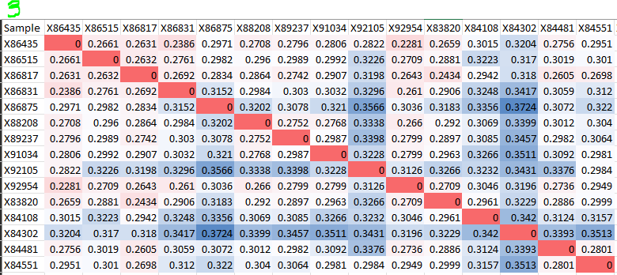
Male in 60plus PCA test separation using adonis by feeding Euclidean distance matrix to the model.
Comparison of Euclidean distance matrix (2) and WEIGHTED unifrac distance matrix (3).
Weighted looks closer to Euclidean, unexpectedly.

Slide 18
What to do next…
So far, the only subset that showed between-group difference was
Male in 60plus Lv3 tree with Unweighted unifrac distance.
So… use this subpopulation for now to see the correlation between food variable and PCoA Axis.

Slide 19
Correlation between Axis values and variables (foods)
.

Slide 20
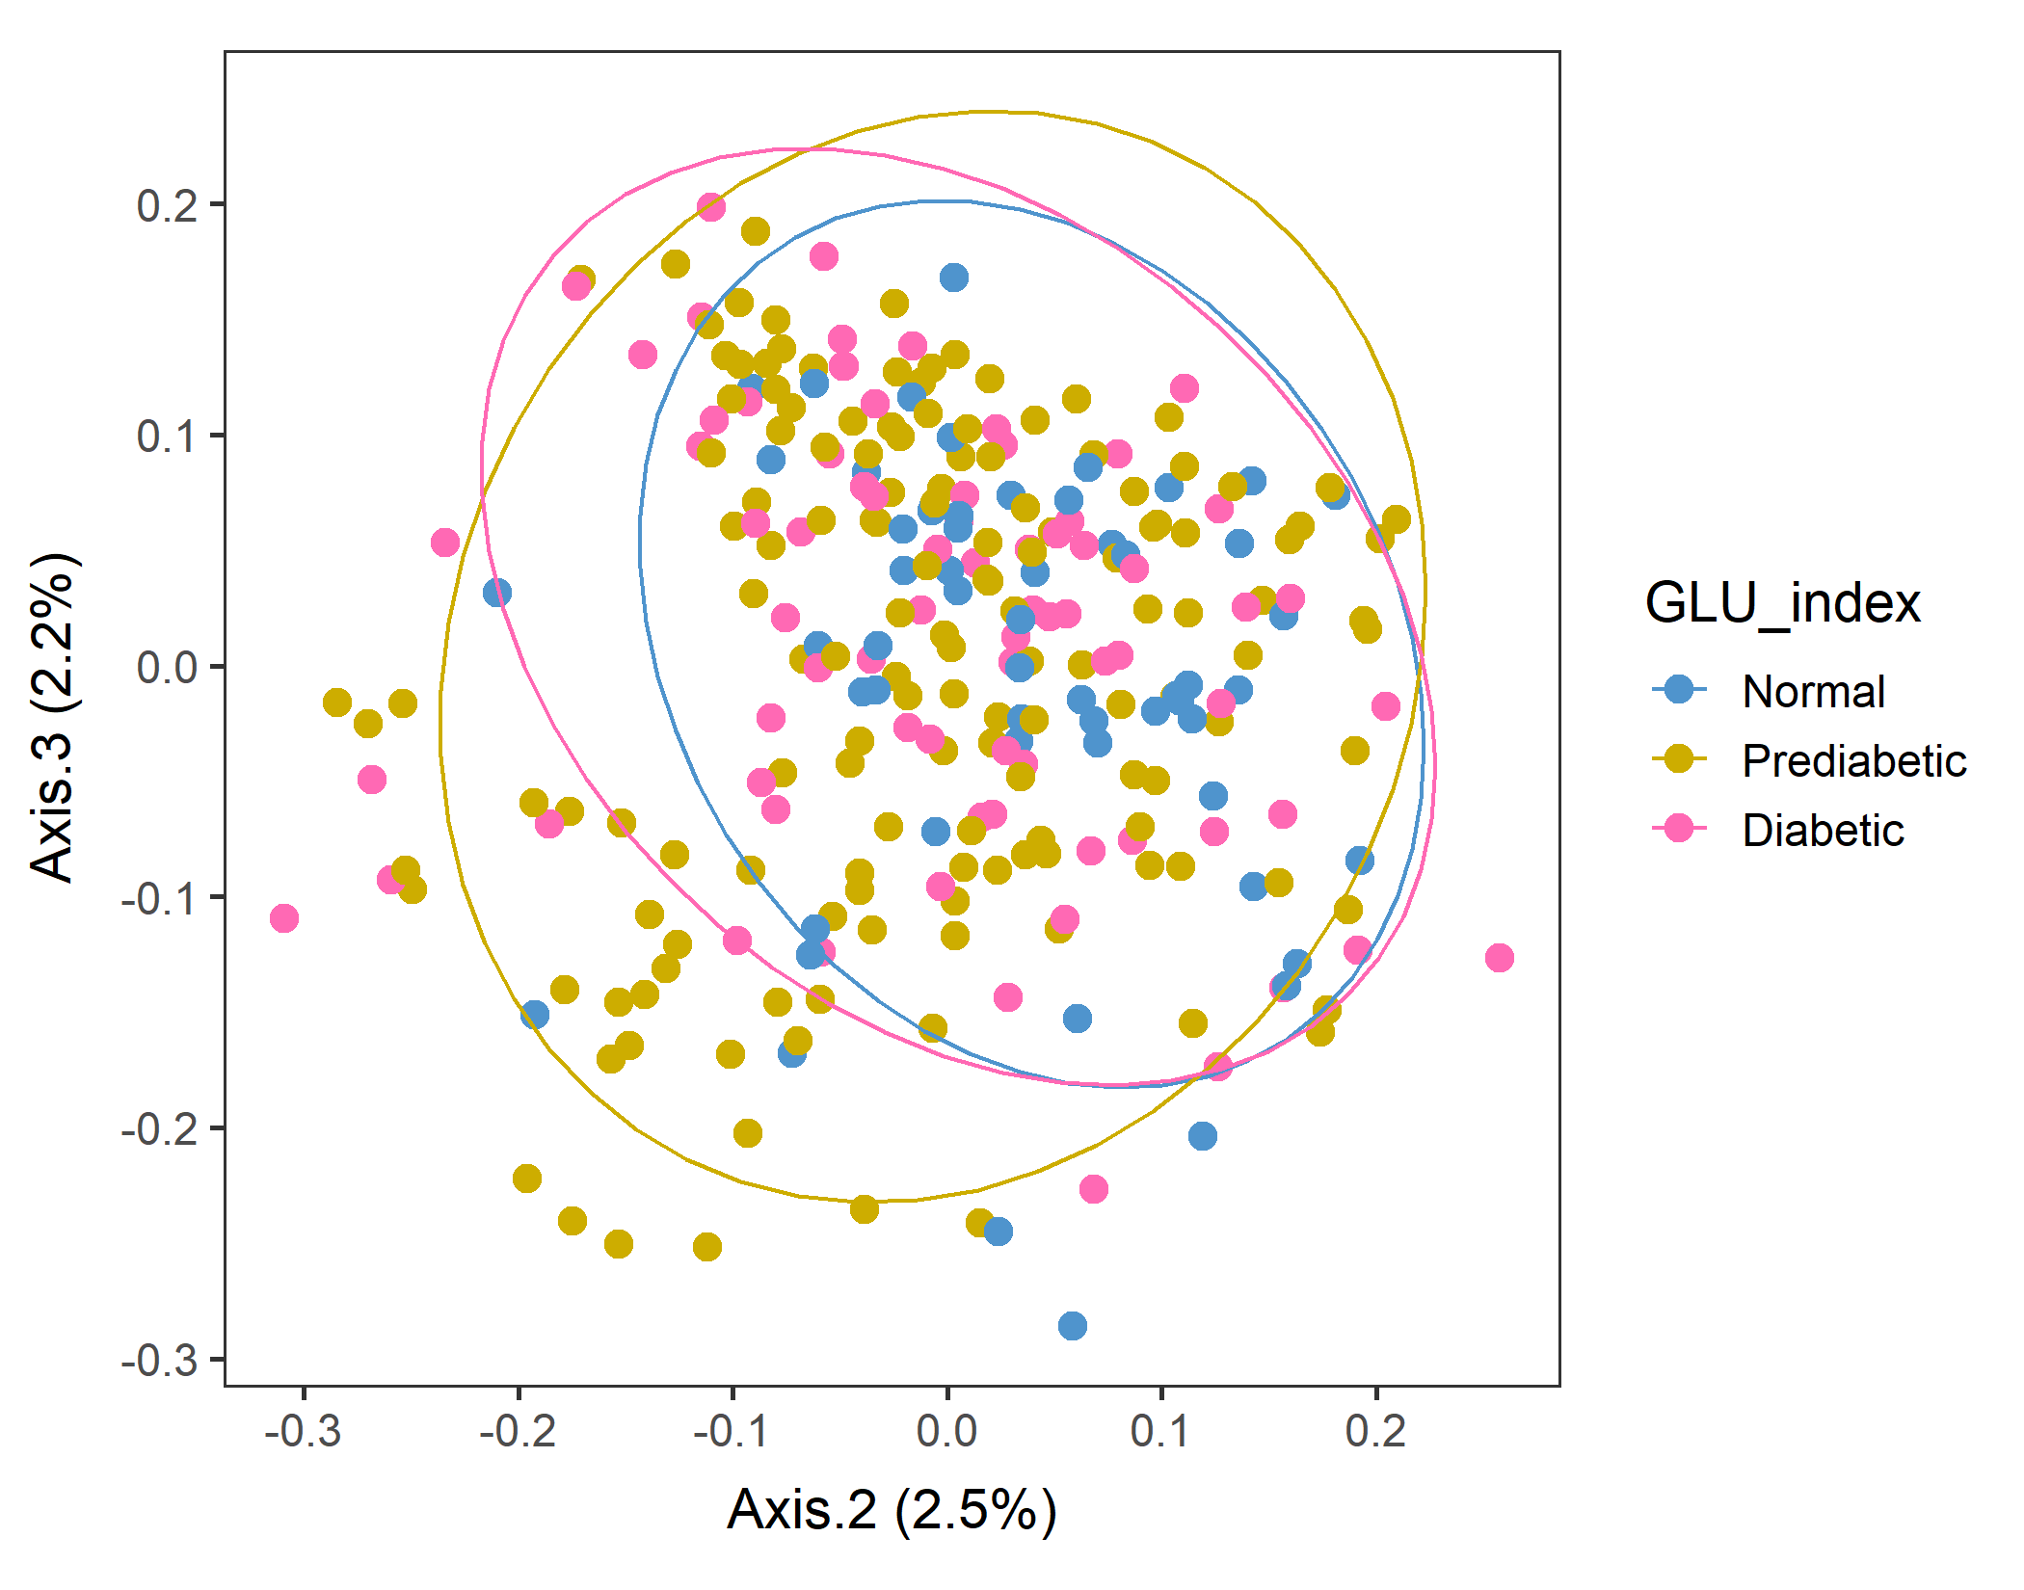
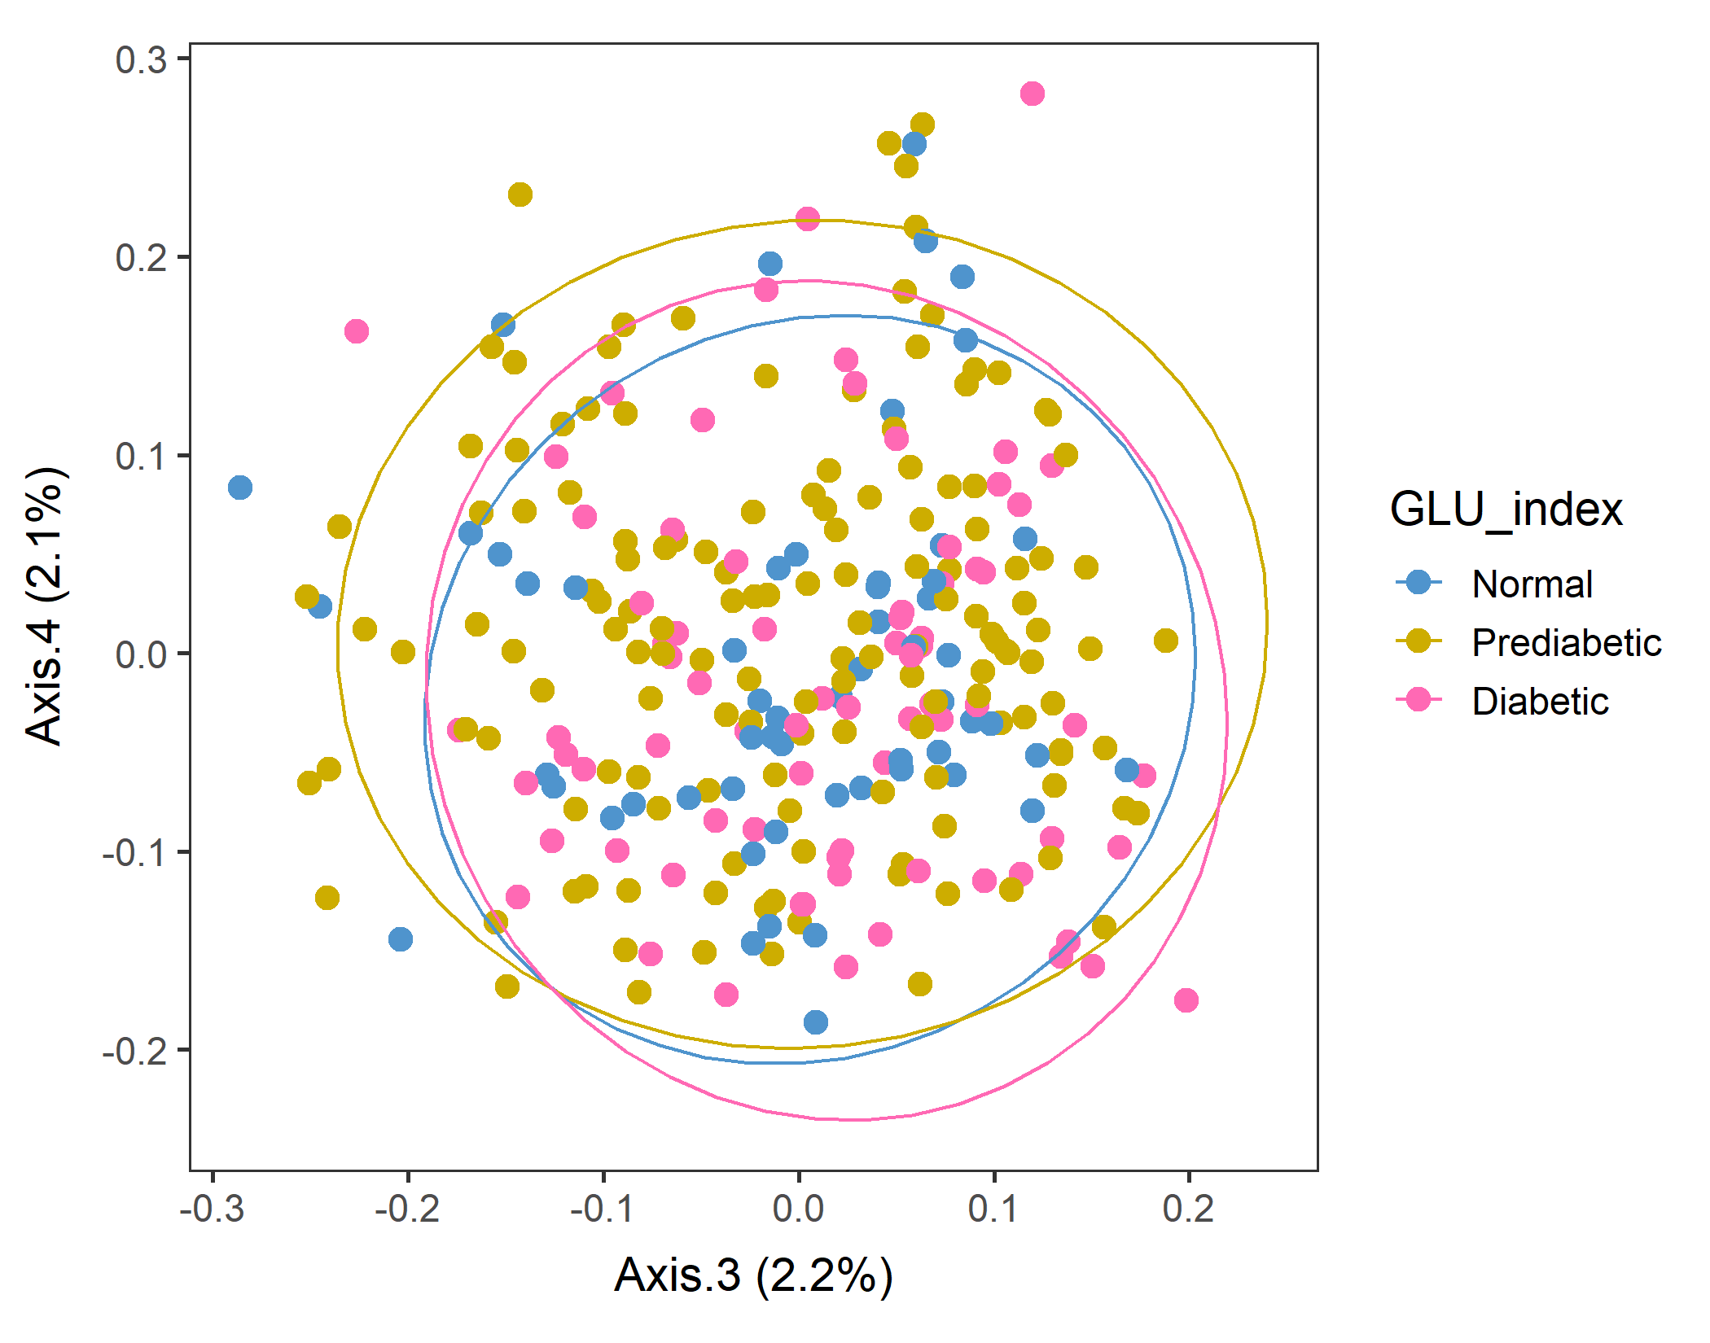
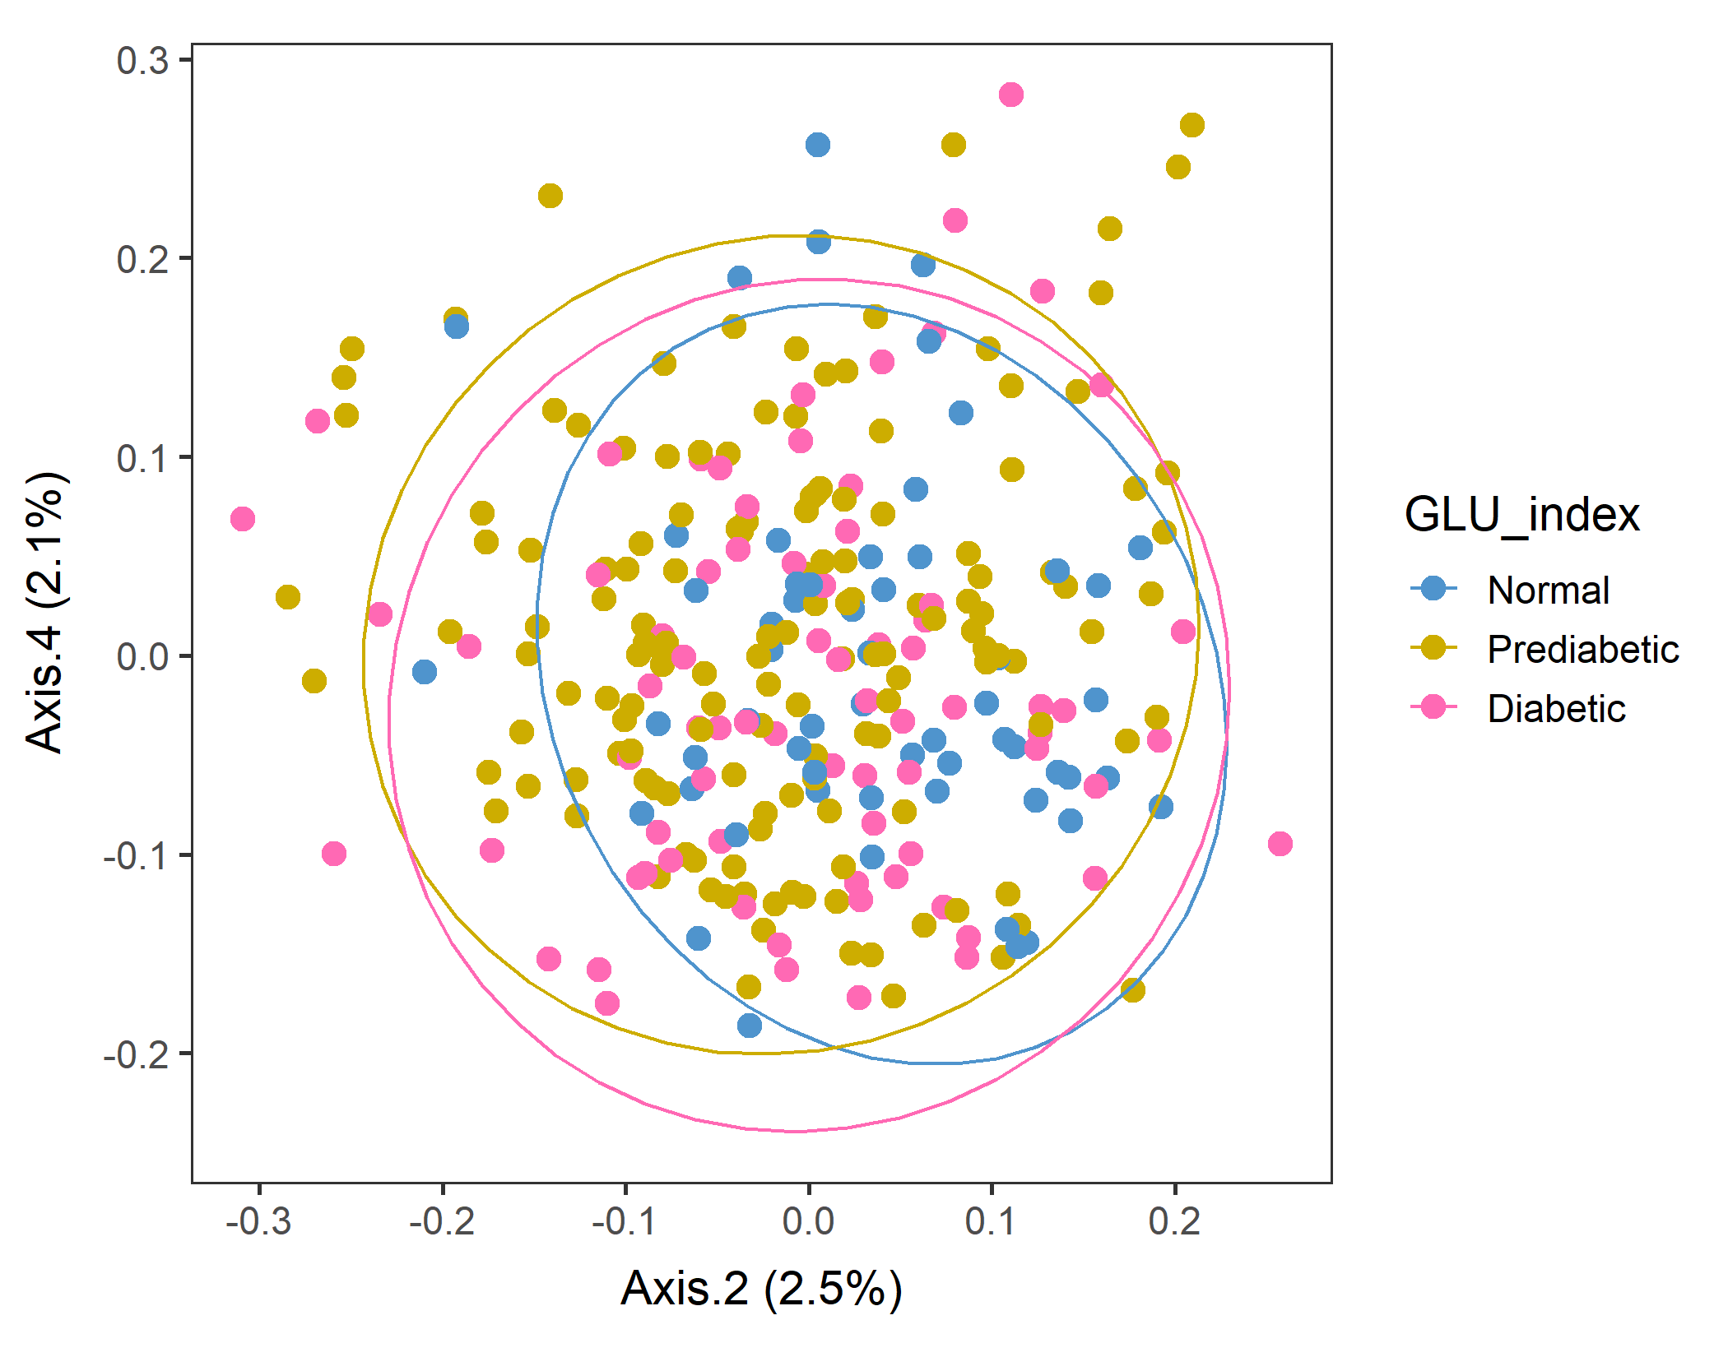
Male in 60plus Lv3 UNweighted
After sorting food by SEQN
vegan::permutest: p-value ~0.86. Assumption OK.
vegan::adonis: p-value:0.007. Groups are different.
Run pairwise adonis (with correct the sample order!). Prediabetic vs Normal are different (p=0.006) but other pairs are not.

Slide 21
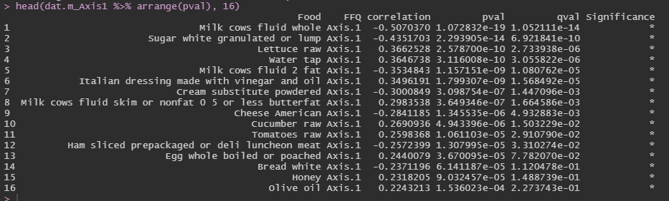
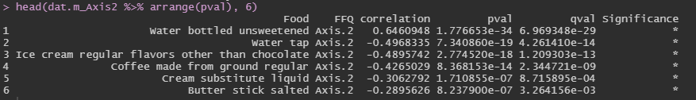
Corr between food groups and Axes: Axes 1 and 2
After sorting food by SEQN, males60plus, Lv3, UNweighted unifrac distance PCoA.
Axis 1 (+) Lettuce, Water, Italian dressing skim milk, Cucumber, Tomatoes, Whole egg, Honey, Olive oil … healthier foods
Axis 1 (–) Whole milk, Sugar, 2% milk, Cream sub, Cheese, Ham, Bread … less healthy foods
Axis 2 (+) Bottoled water
Axis 2 (–) Tap water, Ice cream, Coffee, Cream sub, Butter stick salted
Unweighted distance, so the amounts should not matter, but water is the most correlated variable with the Axes. (?)

Slide 22
Corr between food groups and Axes. (heatmap) Axes 1 and 2
Axis 2 (+) … Bottled water
Axis 2 (–) … Tap water, Ice cream, Coffee, Cream sub, Butter stick salted
Axis 1 (+) … Lettuce, Water, Italian dressing skim milk, Cucumber, Tomatoes, Whole egg, Honey, Olive oil
Axis 1 (–) … Whole milk, Sugar, 2% milk, Cream sub, Cheese, Ham, Bread

Slide 23
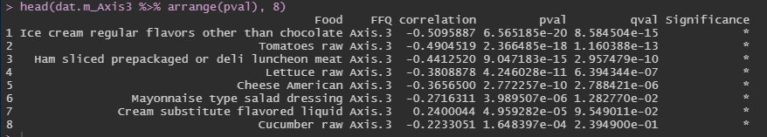
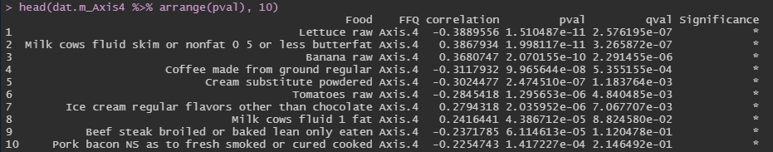
Corr between food groups and Axes: Axes 3 and 4
After sorting food by SEQN, males60plus, Lv3, UNweighted unifrac distance PCoA.
Axis 3 (+) Cream sub
Axis 3 (–) Ice cream, Tomatoes, Ham, Lettuce, Cheese, Mayonnaise-type dressing, Cucumber
Axis 4 (+) Skim milk, Banana, Ice cream, 1%fat milk
Axis 4 (–) Lettuce, Coffee, Cream sub, Tomatoes, Beef steak, Pork bacon

Slide 24
Corr between food groups and Axes. (heatmap) Axes 2 and 3
Axis 3 (+) … Cream sub
Those with lower Axis 2 and lower Axis 3 may have high food intake?
Axis 3 (–) Ice cream, Tomatoes, Ham, Lettuce, Cheese, Mayonnaise-type dressing, Cucumber
Axis 2 (–) … Tap water, Ice cream, Coffee, Cream sub, Butter stick salted
Axis 2 (+) … Bottled water

Slide 25
Corr between food groups and Axes. (heatmap) Axes 2 and 4
Axis 4 (+) … Skim milk, Banana, Ice cream, 1%fat milk
Axis 4 (–) Lettuce, Coffee, Cream sub, Tomatoes, Beef steak, Pork bacon
Axis 2 (–) … Tap water, Ice cream, Coffee, Cream sub, Butter stick salted
Axis 2 (+) … Bottled water

Slide 26
Male with age 60-79 (n=237)

Slide 27
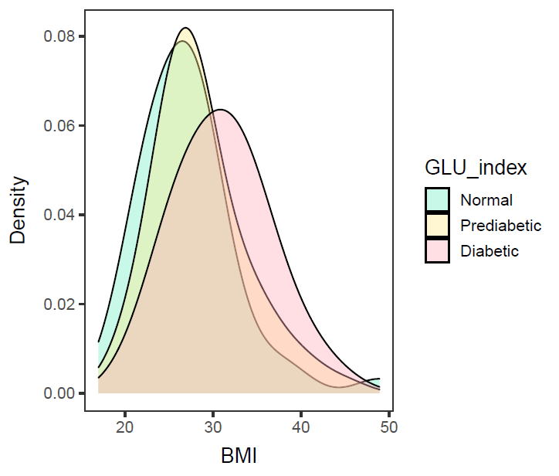
Male in 60-79, BMI (n=234; 3 missing BMI)
ANOVA – significant (p-value= 0.000481).
Diabetic is different from Normal and Prediabetic, but
Normal and Prediabetic are not different.
data: df$BMXBMI and df$GLU_index
Normal Prediabetic
Prediabetic 0.128 -
Diabetic 0.00056 0.00499
Diabetic group has a higher mean BMI than Prediabetic and Normal group.

Slide 28
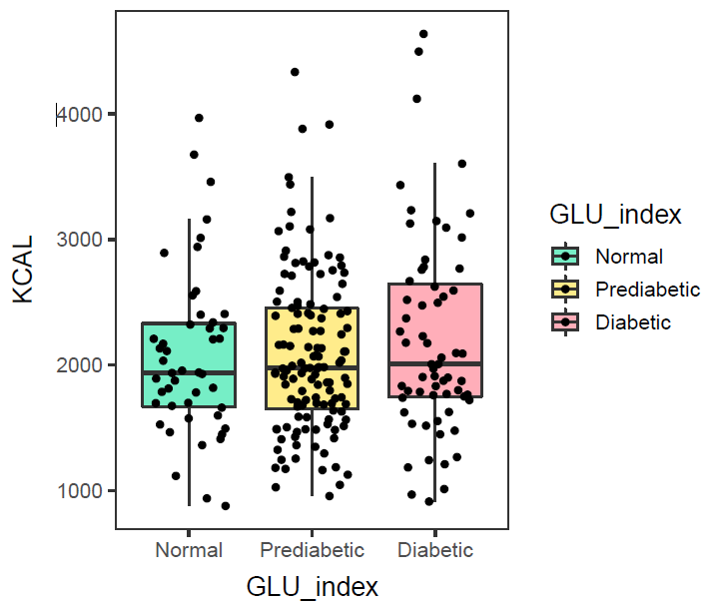
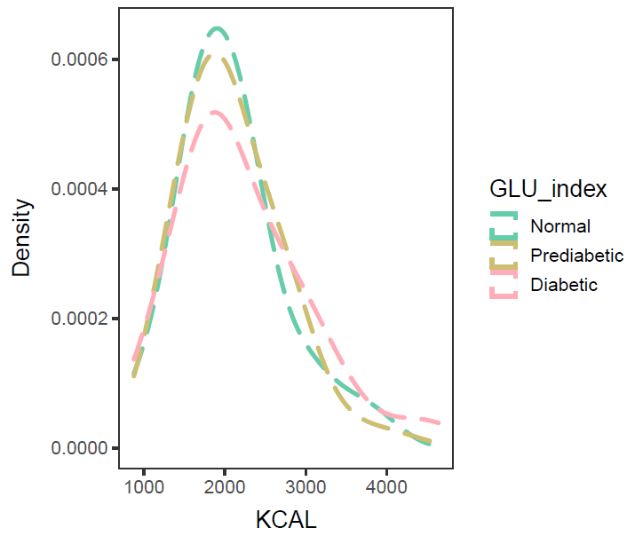
Male in 60-79, KCAL (n=237)
ANOVA – not significant (p-value=0.457).
No need to control KCAL intake.
Calorie intake of Normal, Prediabetic, and Diabetic groups are not different.

Slide 29
Correlation between Axis values and variables (foods)

Slide 30
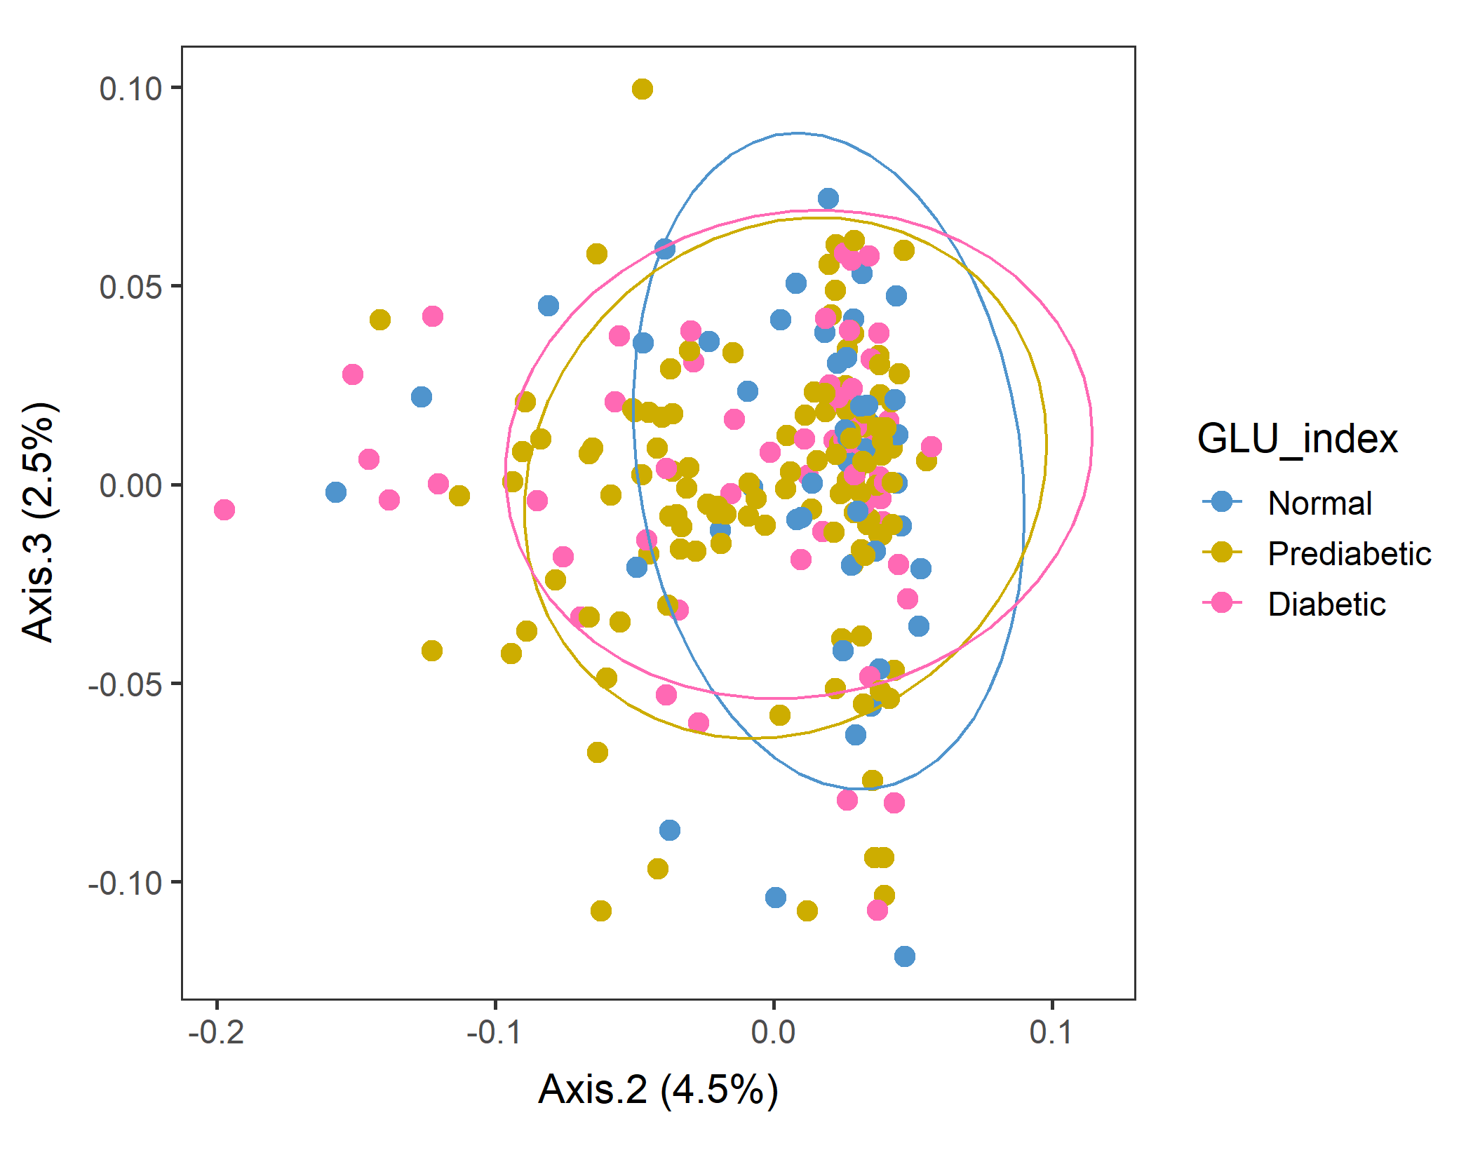
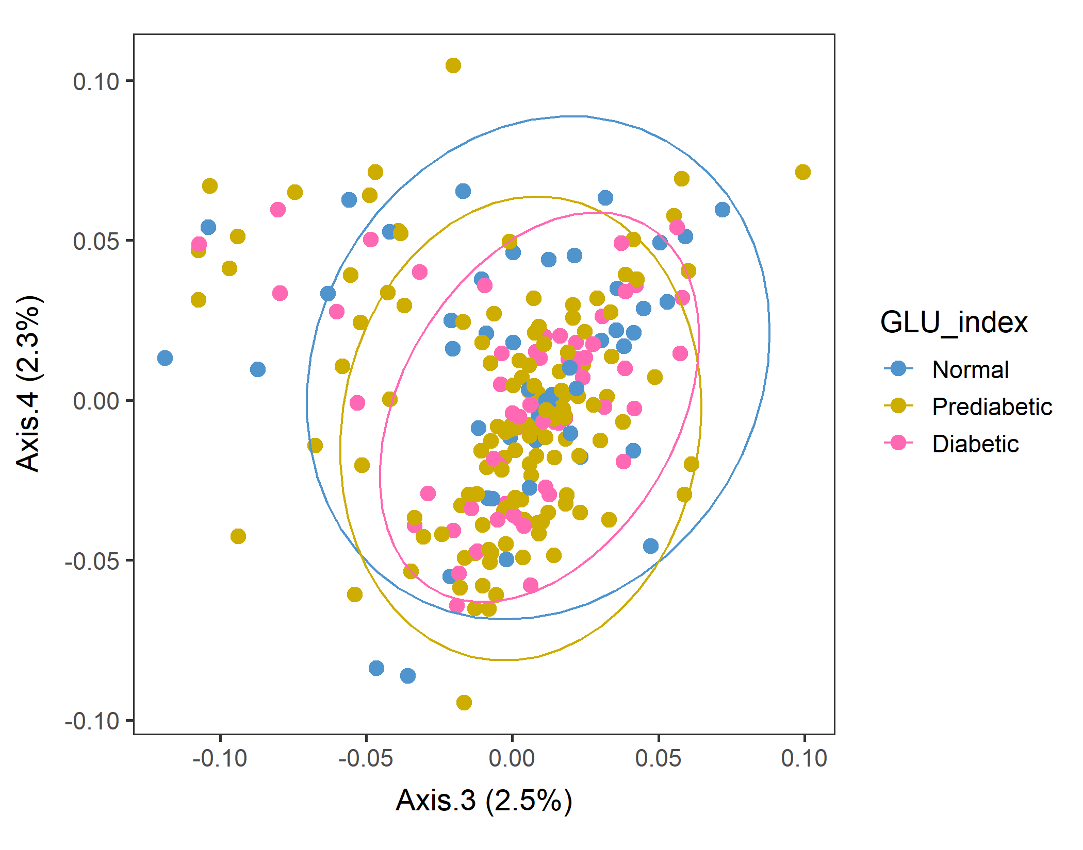
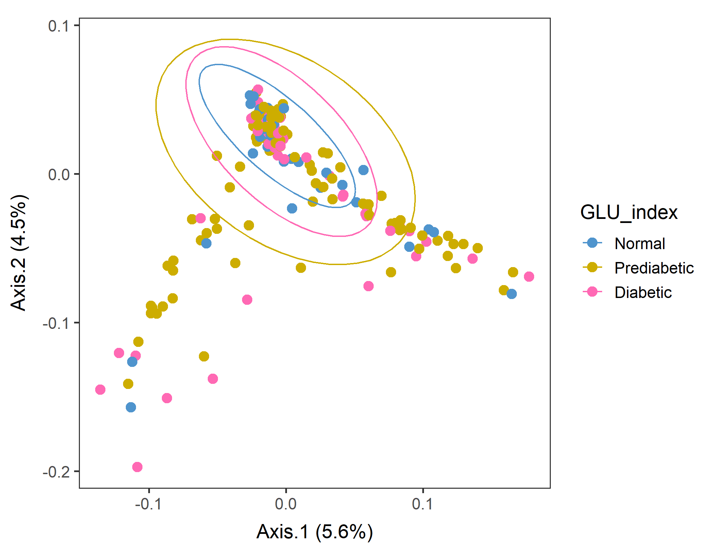
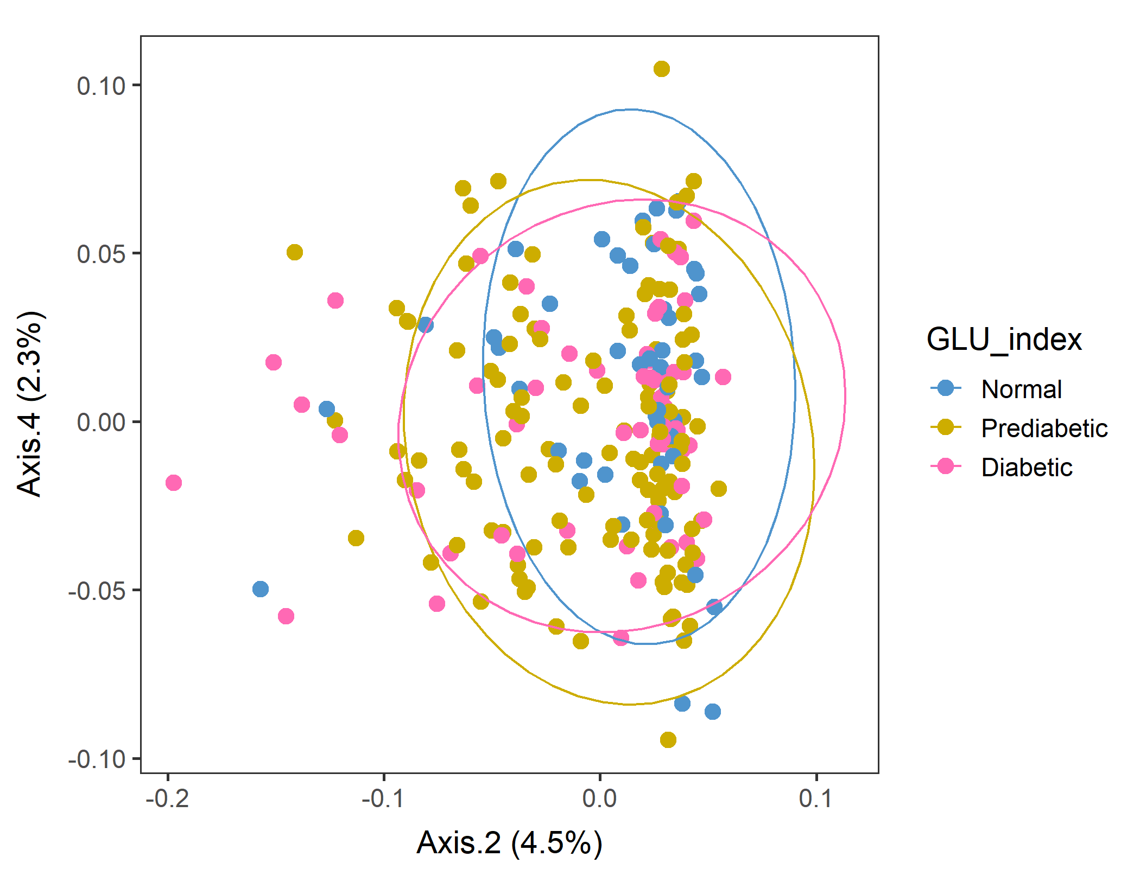
Male in 60-79 Lv3 PCoA with WEIGHTED unifrac distance
After sorting food by SEQN
Looks like Normal population tend to have a higher value of Axis.2.
Conversion failed
vegan::permutest: p-value ~0.05. Borderline, but assumption OK.
vegan::adonis: p-value 0.09. Groups are borderline but not different.

Slide 31
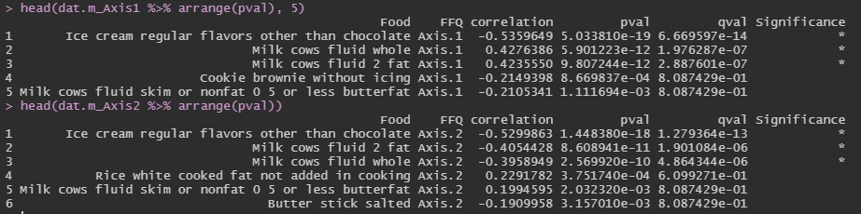
Corr between food groups and Axes: Axes 1 and 2
After sorting food by SEQN, males60to79, Lv3, WEIGHTED unifrac distance PCoA.
The foods that had the highest correlation with Axes 1&2 were almost the same – ice cream and milks. Banana foor Axis 1, and American cheese for Axis 2.

Slide 32
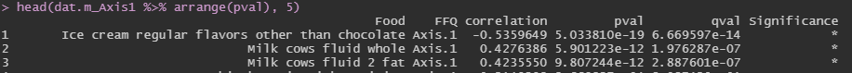
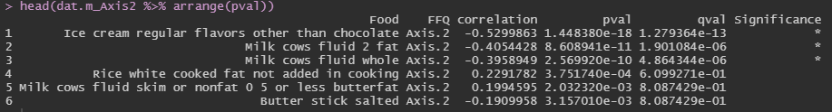
Corr between food groups and Axes. (heatmap) Axes 1 and 2
Axis 1 (+) and Axis 2 (–) …
Milk?
Axis 1 (–) and Axis 2 (–) …
Ice cream

Slide 33
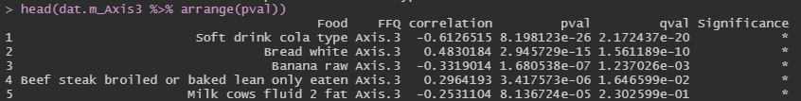
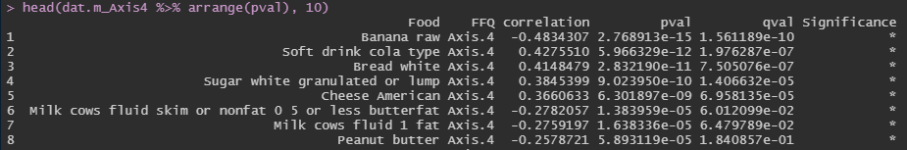
Corr between food groups and Axes: Axes 3 and 4
The foods that had the highest correlation with Axes 3&4 were – Soft drinks (Cola type), White bread, milk.
Also, White sugar and Cheese for Axis 4.
Axis 4 (+) were less healthy foods such as soft drinks, sugar, white bread, cheese.

Slide 34
Corr between food groups and Axes. (heatmap) Axes 2 and 3
Axis 3 (+) … White bread, lean beef steak
Axis 2 (–) were somewhat unhealthy dairy products such as ice cream, 2% or whole milk.
Prediabetic, and Diabetic groups shifting to less Axis 2 values. Makes sense accounting for their BMI…?
Axis 3 (–) … soft drink, raw banana, 2% milk
Axis 2 (+) … (rice, nonfat milk; not significant)
Axis 2 (-) … ice cream, 2%, whole milk

Slide 35
Corr between food groups and Axes. (heatmap) Axes 2 and 4
Axis 4 (+) … soft drinks, white bread, sugar, cheese
Axis 4 (+) were less healthy foods such as soft drinks, sugar, white bread, cheese, beer.
But GLU groups do not show much difference in the Axis 4 direction in Axis2&4 plot.
Axis 4 (–) … raw banana, nonfat or 1% milk, peanut butter
Axis 2 (+) … (rice, nonfat milk; not significant)
Axis 2 (-) … ice cream, 2%, whole milk

Slide 36

Corr between food groups and Axes.
When male subjects aged 60-79 were separated by their dietary patterns with weighted unifrac distance, ice cream was the key food category that separated them.. interesting.

Slide 37
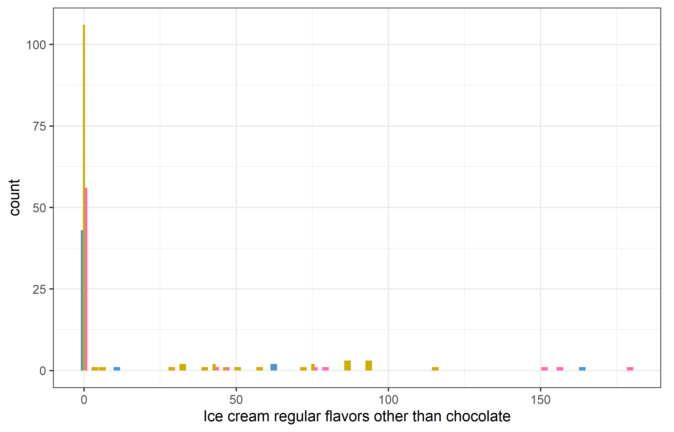
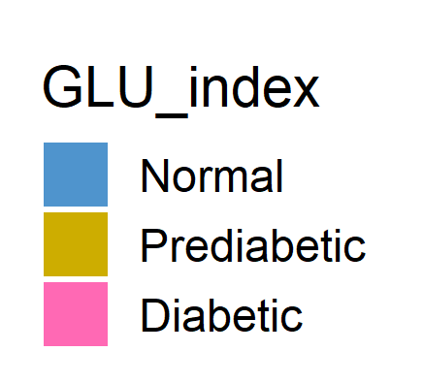
males60to79_red_Lv3_ord_WEIGHTED_corr_icecream_GLU
Food OTU table + GLU_index → plot “ice cream regular flavors other than chocolate” consumption and color code by GLU_index.
Most people did not consume ice cream, but some did. And most of them were either prediabetic or diabetic. That’s why the correlation was strong..

Slide 38
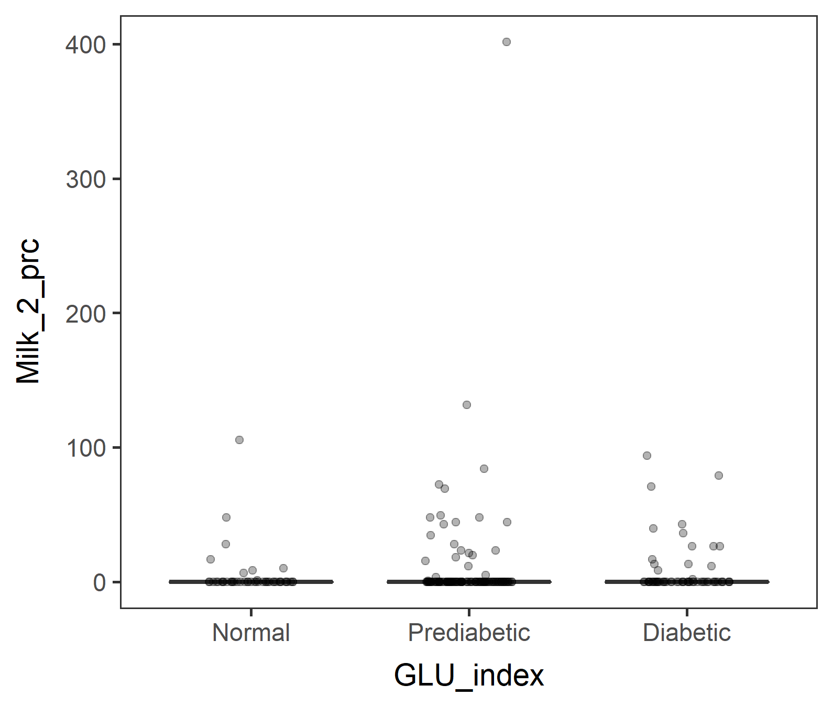
males60to79_red_Lv3_ord_WEIGHTED_corr_2%milk_GLU
Food OTU table + GLU_index → plot “Milk cows fluid 2 fat” consumption and color code by GLU_index.
Similarly to ice cream,
Most people did not consume 2% milk, but some did. And more prediabetic and diabetic people did.

Slide 39
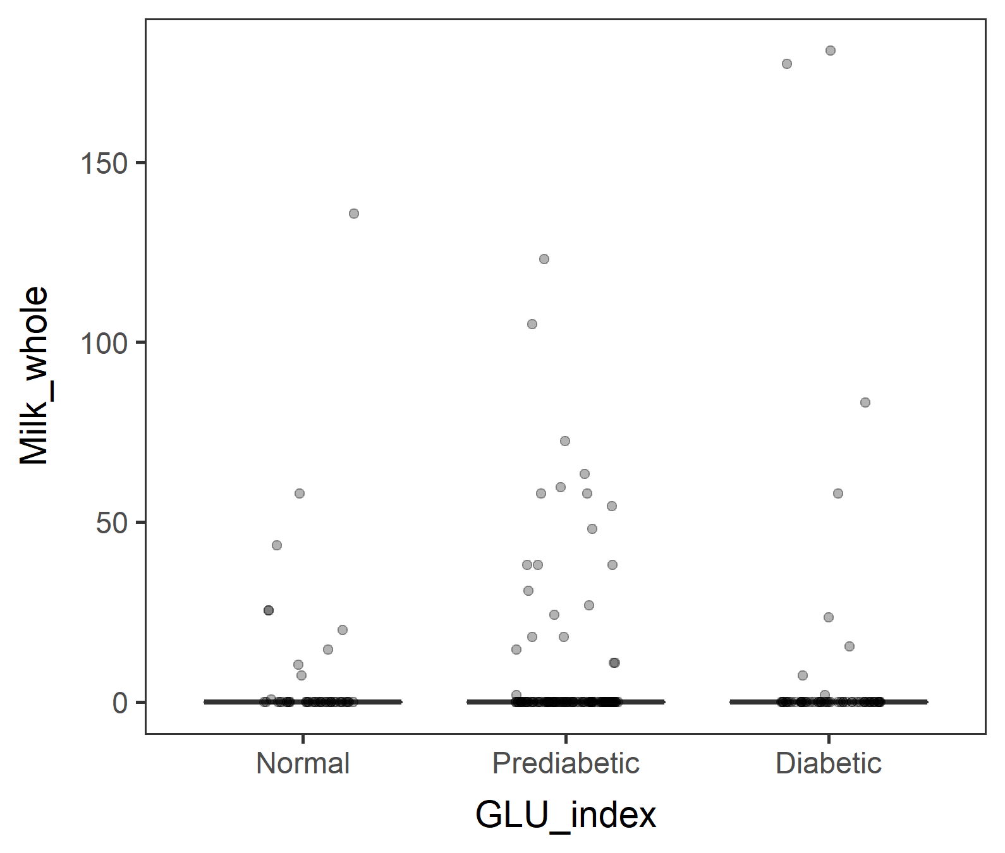

males60to79_red_Lv3_ord_WEIGHTED_corr_wholemilk_GLU
Food OTU table + GLU_index → plot “Milk cows fluid whole” consumption and color code by GLU_index.
Similarly to ice cream and 2% milk but difference not as obvious. Plus, Prediabetic group outnumbers Normal and Diabetic groups. That difference is accounted for…?

Slide 40
How to adjust sample size difference
Divide Prediabetic group into two – high and low. And make an argument that Prediabetic spectrum is a continuum.
OR
Bootstrapping - Random sampling of prediabetic

Slide 41


Divide Prediabetic group into two – high and low. (Make an argument that Prediabetic spectrum is a continuum.)
If 112.5 was the threshold, too many Prediabetic_L
If 110 was the threshold, well-balanced.
But it’s a bit strange to have thresholds of 100, 110, 126 for separating Normal, Prediabetic_L, Prediabetic_H, and Diabetic.
15_subset_NHANES_males60to79_PredLH.R

Slide 42



Bootstrapping - Random sampling of prediabetic
Take 55 random samples of Prediabetics, so
ANOVA insignificant (p= 0.392)
BMI: ANOVA significant (p= 0.00105)
Normal and Prediabetic are not different, but Diabetic was different from Normal (p=0.0008) and Prediabetic (p=0.0427)

Slide 43

Bootstrapping - Random sampling of prediabetic

Slide 44




Male in 60to79 Lv3 WEIGHTED
Random sampling of prediabetic
vegan::permutest: p-value ~0.06. Assumption OK.
vegan::adonis: p-value 0.36. Groups are not different.

Slide 45




Male in 60to79 Lv3 UNWEIGHTED
Random sampling of prediabetic
vegan::permutest: p-value 0.39. Assumption OK.
vegan::adonis: p-value 0.02. Groups are different.
Diabetic vs Normal are different. (p: 0.026)
Try bootstrapping many times.

Slide 46
Try bootstrapping many times.
Take random 55 samples from Prediabetic
|
Generate food tree, OUT table, tax table.
|
Generate phyloseq object
|
Ordination and save p-values of
adonis::bdisp,
adonis::vegan,
pairwise.adonis, only if adonis is significant. If not, “NA”.
(n=10)
number | dist.p | adonis.p | <0.05
1 | 0.716 | 0.090
2 | 0.190 | 0.020 | *
3 | 0.068 | 0.014 | *
4 | 0.406 | 0.056
5 | 0.494 | 0.048 | *
6 | 0.094 | 0.003 | *
7 | 0.580 | 0.106
8 | 0.754 | 0.080
9 | 0.496 | 0.009 | *
10 | 0.640 | 0.021 | *
Mean | 0.444 | 0.045

Slide 47




Try bootstrapping (n=10)
1 means the pair of comparison was different for each of the 10 runs.
Run 10 results where Diabetic and Normal groups were different.
number | Dia_vs_Nor | Dia_vs_Pre | Pre_vs_Nor
1 | NA | NA | NA
2 | 0 | 0 | 0
3 | 0 | 1 | 1
4 | NA | NA | NA
5 | 1 | 0 | 0
6 | 0 | 1 | 1
7 | NA | NA | NA
8 | NA | NA | NA
9 | 0 | 1 | 1
10 | 1 | 0 | 0
Total | 2 | 3 | 3

Slide 48
Try bootstrapping (n=100)
(n=100)
Of 100 runs, adonis was significant 50 times, so pairwise comparison was done 50 times.
 | dist.p | adonis.p
Mean | 0.426 | 0.070
1 means the pair of comparison was different for each of the 100 runs.
 | Dia_vs_Nor | Dia_vs_Pre | Pre_vs_Nor
Total | 25 | 8 | 8
Hmmmm… not conclusive, but at least I can provide the script (300 lines of a loop) for a simulation like this.
Can do more, only takes 20 sec/run.

Slide 49
males60to79_red_Lv3_ord_WEIGHTED_corr is done!!
Next, I could do…
males60to79_red_Lv3_ord_UNweighted_corr

Slide 50




Male in 60-79 Lv3 PCoA with Unweighted unifrac distance
After sorting food by SEQN
Checked that ordination results are the same even after sorting SEQN columns in food object first. Though mirrored, but separation and % var explained are the same.
vegan::permutest: p-value ~0.6. Assumption OK.
vegan::adonis: p-value:0.07. Groups are borderline but not different.

Slide 51
Corr between food groups and Axes. (heatmap) Axes 1 and 2
Unweighted
The foods that had the highest correlation with Axes 1&2 were almost the same – ice cream and milks. Banana foor Axis 1, and American cheese for Axis 2.

Slide 52
Ordination with an Euclidean distance matrix
.

Slide 53
Male in 60to79 Test separation using adonis by feeding Euclidean distance matrix to the model.
dist_matrix_e <- dist(as.data.frame(t(food2)), method = "euclidean", diag = T)
vegan::adonis(DISTANCE_MATRIX, FACTOR, perm=999)
In theory, it can handle any distance matrix, even Euclidean.
vegan::permutest: p-value ~0.5. Assumption OK.
vegan::adonis: p-value”: 0.06. Groups are not different.
> pairwise.adonis(dist_matrix_e, demog_glu_male60to79$GLU_index, perm = 5000)
pairs Df SumsOfSqs F.Model R2 p.value p.adjusted sig
1 Diabetic vs Prediabetic 1 70294.36 1.110221 0.005870760 0.1261748 0.3785243
2 Diabetic vs Normal 1 76511.31 1.108867 0.010162941 0.1113777 0.3341332
3 Prediabetic vs Normal 1 73829.27 1.131156 0.006533519 0.1403719 0.4211158
.

Slide 54
[sorted food$SEQN first] Male in 60to79 PCA test separation using adonis by feeding Euclidean distance matrix to the model.
Safety Check
dist_matrix_e <- dist(as.data.frame(t(food2)), method = "euclidean", diag = T)
vegan::adonis(DISTANCE_MATRIX, FACTOR, perm=999)
In theory, it can handle any distance matrix, even Euclidean.
vegan::permutest: p-value ~0.5. Assumption OK.
vegan::adonis: p-value”: 0.06. Groups are not different.
> pairwise.adonis(dist_matrix_e, demog_glu_male60to79$GLU_index, perm = 5000)
pairs Df SumsOfSqs F.Model R2 p.value p.adjusted sig
1 Diabetic vs Prediabetic 1 70294.36 1.110221 0.005870760 0.1261748 0.3785243
2 Diabetic vs Normal 1 76511.31 1.108867 0.010162941 0.1113777 0.3341332
3 Prediabetic vs Normal 1 73829.27 1.131156 0.006533519 0.1403719 0.4211158
After sorting the individuals (X86435 etc.) in food, then prepare OUT table → produced the same result!
Creating phyloseq object with sorted individuals (in colulmns) in food first → then build phyfoods → Do ordination → Will be safer.

Slide 55
Most updated scripts are….
40_ordination_NHANES_males60to79_Lv3_Euclidean_sortfood.R
40_ordination_NHANES_males60to79_Lv3_explore_sortfood.R
If I am going to use males60plus, I will need to update males60plus scripts to reflect the change (to sort the columns of SEQN in food before creating a phyloseq object).

Slide 56
Food tree level argument
.

Slide 57



The level argument in food tree
1274 food items were reported by the subpopulation, males 60-79.
The level argument in make.food.tree is how much detailed classification (taxonomy info) you would like to have within your tree.
Lv 1
Lv 2
Lv 3
A nice figure to add to our preprint (Abby)

Slide 58


taxonomy column in Food OUT table
males60to79_red_Lv1.dhydrt.otu.txt (1274 tips and 10 internal nodes)
males60to79_red_Lv2.dhydrt.otu.txt (1274 tips and 54 internal nodes)
males60to79_red_Lv3.dhydrt.otu.txt (1274 tips and 210 internal nodes)
Actually the number of leaves (food products) is the same across all levels. The number of branches inside the tree is different. The levels argument specifies how much detailed classification of each food items to include in your tree.

Slide 59
Count the number of food items at each level
L1 | L1 count
L1: Milk | 74
L1: Vegetables | 200
L1: Carb | 1000
Total | 1274
L1 | L1 count | L2 | L2 count
L1: Milk | 74 | L2: Milk fluid | 70
 |  | L2: Milk solid | 4
L1: Vegetables | 200 | L2: Green | 100
 |  | L2: Root | 100
L1: Carb | 1000 | L2: Wheat | 800
 |  | L2: Rice | 200
Total | 1274 |  | 1274

Slide 60

Can collapse by food levels!
# collapse at different levels? split <- strsplit(rownames(food),";") foodStrings <- sapply(split,function(x) paste(x[1:3],collapse=";")) food<- rowsum(food,foodStrings)
# more complicated
fungal <- t(fungal) split <- strsplit(rownames(fungal),";") taxaStrings <- sapply(split,function(x) paste(x[1:7],collapse=";")) for (i in 1:7) taxaStrings = gsub("(;[A-z]__$)?(;NA$)?","",taxaStrings,perl=T) # clean tips fungal <- rowsum(fungal,taxaStrings) rownames(fungal) = sapply(strsplit(rownames(fungal),";"),function(x) paste(x[1:7],collapse=";")); fungal <- as.data.frame(t(fungal))

Slide 61
Misc.
For record-keeping purposes

Slide 62
Male in 60s Lv2 and Lv3 – more variance explained?
Kind of yes –
Axis 1 of Lv3 weighted is high.
Lv2 weighted is as good as Lv4 weighted.
In general, PCoA with weighted (unifrac distance) is better than unweighted.
Order of levels of GLU_index is incorrect, but the results (var explained) itself is not wrong.

Slide 63
Mistake in 40_ordination_NHANES_xxxx found!!
# Convert the GLU_index as a factor to plot it in order.
loaded_glu_u$GLU_index <- factor(loaded_glu_u$GLU_index, labels= c("Normal", "Prediabetic", "Diabetic"))
This must be levels, not labels!!!!
# Change the plot colors so that new figures with correct levels can be distinguished from the incorrect ones…
colors c("turquoise2", "goldenrod3", "mediumvioletred“) --> replaced with c("steelblue3", "gold3", "hotpink“)

Slide 64




Male in 60s Lv2 WEIGHTED
Order of levels of GLU_index is incorrect!!
Axes 1&2 biplot separated Normal group
Axes 2&4 biplot separated Diabetic group
vegan::permutest: p-value ~0.3. Assumption OK.
vegan::adonis: p-value 0.02. Groups are different.

Slide 65




Male in 60s Lv2 UNweighted
Order of levels of GLU_index is incorrect!!
vegan::permutest: p-value ~0.7. Assumption OK.
vegan::adonis: p-value 0.02. Groups are different!

Slide 66




Male in 60s Lv3 WEIGHTED
Order of levels of GLU_index is incorrect!!
vegan::permutest: p-value ~0.49. Assumption OK.
vegan::adonis: p-value 0.054. Groups are borderline different.

Slide 67




Male in 60s Lv3 UNweighted
Order of levels of GLU_index is incorrect!!
vegan::permutest: p-value ~0.57. Assumption OK.
vegan::adonis: p-value 0.03. Groups are different!

Slide 68




Male in 60s Lv4 WEIGHTED
Order of levels of GLU_index is incorrect!!
Axes 3&4 biplot and Axes 2&4 biplot separated Diabetic group
vegan::permutest: p-value ~0.18. Assumption OK.
vegan::adonis: p-value 0.05. Groups are borderline different.
Maybe 3D will work…?

Slide 69




Male in 60s Lv4 UNweighted
Order of levels of GLU_index is incorrect!!
Axes 2&4 biplot separated Normal group
For both weighted and unweighted, Axes 2&4 separated groups.
Unweighted is presence or absence.
vegan::permutest: p-value ~0.27. Assumption OK.
vegan::adonis: p-value 0.05. Groups are borderline different. But in this, Prediabetic looks different from the others.

Slide 70


Male in 60s Lv5
Order of levels of GLU_index is incorrect!!
Lv5_ord_WEIGHTED, no error in ordination
Lv5_ord_UNweighted
vegan::permutest: p-value ~0.10. Assumption OK.
vegan::adonis: p-value 0.08. Groups are almost borderline different.
vegan::permutest: p-value ~0.50. Assumption OK.
vegan::adonis: p-value 0.05. Groups are borderline different.

Slide 71



Male in 60-79 Lv3 PCoA with WEIGHTED unifrac distance
BEFORE sorting food by SEQN, I think…
Looks like Normal population tend to have a lower value of Axis.2.
Conversion failed
vegan::permutest: p-value ~0.06. Borderline, but assumption OK.
vegan::adonis: p-value 0.09. Groups are borderline but not different.

Slide 72




Male in 60-79 Lv3 PCoA with Unweighted unifrac distance
BEFORE sorting food by SEQN, I think…
vegan::permutest: p-value ~0.6. Assumption OK.
vegan::adonis: p-value:0.06. Groups are borderline but not different.

Slide 73
Males in 60s Lv4 and Lv5
Ordination results are influenced by
- food tree level and
- whether weighted or unweighted unifrac distance
is used.
But at level 4 and level 5, the three GLU index groups are almost different, while their dispersions are not different.

Slide 74
Males in 60s Lv6
ordinated_w <- phyloseq::ordinate(phyfoods, method="PCoA", distance="unifrac", weighted=TRUE)
# GIVES ERROR...
Error in h(simpleError(msg, call)) :
error in evaluating the argument 'x' in selecting a method for function 'colSums': subscript out of bounds
Lv6 food tree can be visualized with no problem, but ordination cannot be done…

Slide 75


Males in 60s PCA Nutrients
Prediabetic and Diabetic has points in the top right direction. That is associated with higher general food intake..? TFAT, SODI, etc.

Slide 76

Males in 60s BMI
ANOVA – significant (p-value=0.0026).
Diabetic is different from Normal and Prediabetic, but
Normal and Prediabetic are not different.
data: df$BMXBMI and df$GLU_index
Normal Prediabetic
Prediabetic 0.2471 -
Diabetic 0.0036 0.0115
Diabetic group has a higher mean BMI than Prediabetic and Normal group.

Slide 77


Males in 60s KCAL
ANOVA – not significant (p-value=0.109).
Calorie intake of Normal, Prediabetic, and Diabetic groups are not different...

Slide 78


Male in 60s PCA Nutrients

